Slide 1
Intangible cultural heritage and sustainable development Unit 8 PowerPoint presentation
UNESCO Intangible Cultural Heritage Section

Slide 2
Exercise 1: Participants’ knowledge and experience
Culture and development: An initial discussion based around participants' knowledge and experience of culture and development, inspired by viewing a video on this topic
1 hour

Slide 3
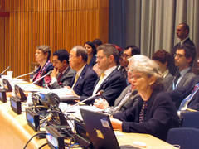
Culture in the United Nations Agenda
2005 World Summit on the Millennium Development Goals (MDG)
2010 MDG Summit outcome document
2011 Resolution 66/208 Culture and development
2015 2030 Agenda for Sustainable Development
The Director-General of UNESCO, Irina Bokova, addresses the United Nations General Assembly, June 2013.
© UNESCO/Eliot Minchenberg

Slide 4
2030 Agenda for Sustainable Development
Transforming our world
3 principles | 3 + 1 dimensions
human rights (cultural rights) | social
sustainability | environmental
equality | economic
 | + peace
17 integrated and indivisible objectives
Recognizing cultural diversity and the contribution of cultures

Slide 5
Cultural rights
Article 5 – Cultural rights as an enabling environment for cultural diversity
Cultural rights are an integral part of human rights, which are universal, indivisible and interdependent.
The flourishing of creative diversity requires the full implementation of cultural rights.

Slide 6
Sustainable development
‘A development which meets the needs of the present without compromising the ability of future generations to meet their own needs’ (Brundtland Commission 1987)
A balance that is difficult to find in working towards a better future

Slide 7
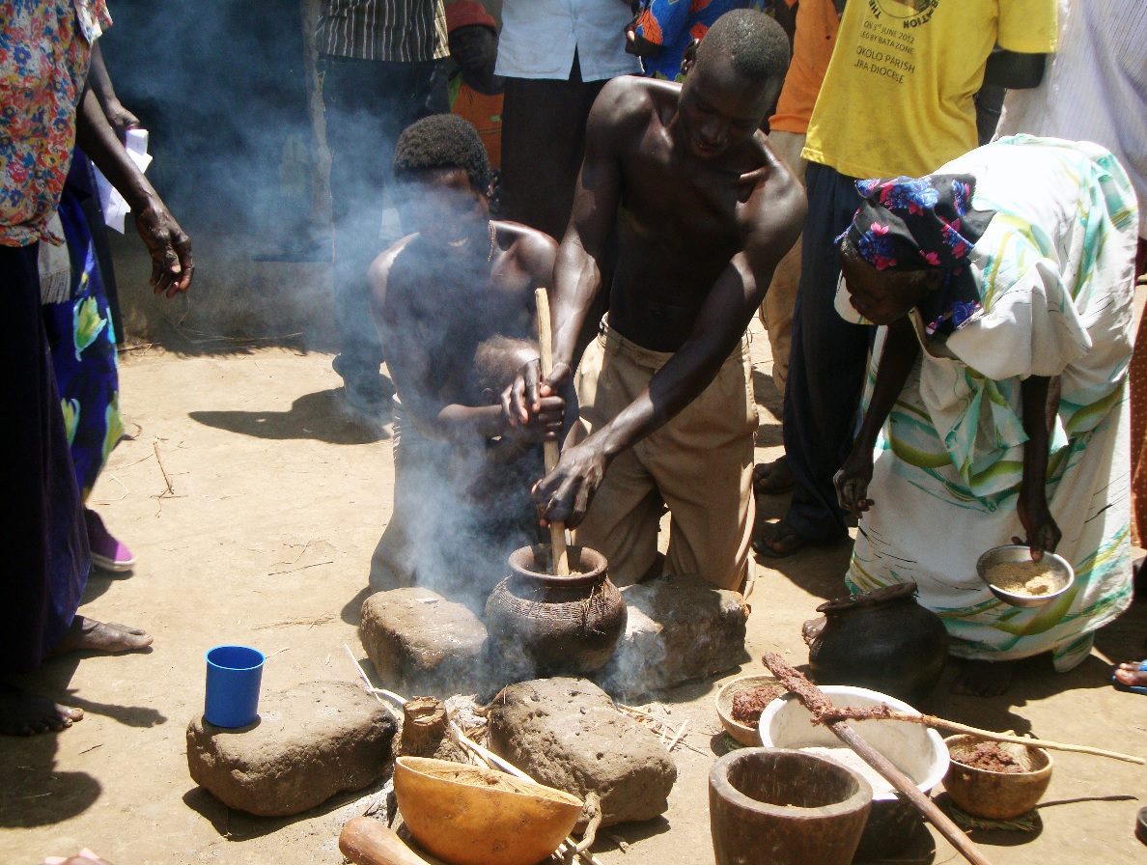
Culture – essential for inclusive social development
Male-child cleansing ceremony of the Lango of central northern Uganda
© Daniel Kaweesi, 2013
Notes:
Culture is becoming more and more central for communities, who ask for better governance and increased cultural choices while seeking to ensure that they have a voice in cultural decision making
Culturally-informed development is crucial to ensure that development is made relevant to a range of populations, including indigenous peoples, with appropriate recognition of their cultural rights, and with their traditional knowledge systems, their rich diversity of environmental and sustainability practices, and their own cultural heritage. Culture, understood this way, makes development more sustainable and inclusive.
Culture and development programmes enable local people and government institutions to play a leadership or centre role conducive both to the appropriation process and to national ownership recommended in the 2005 Paris Declaration
Culture and development programmes enable local people
and government institutions to play a central role conducive to both
appropriate process and national ownership

Slide 8
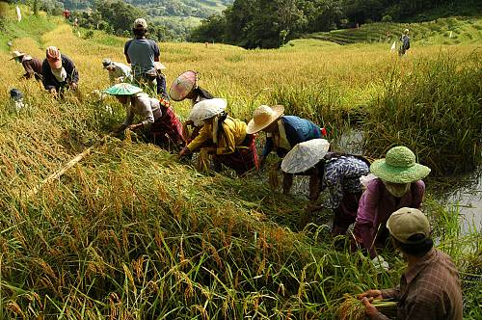
Culture – essential for
environmental sustainability
Hudhud chants of the Ifugao
© 2008 by J. Uñalivia/NCCA-IHC

Slide 9
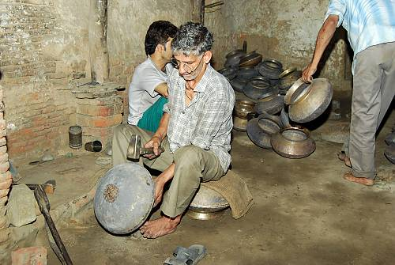
Culture – essential for inclusive economic development
Traditional brass and copper craft of utensil making among the Thatheras of Jandiala Guru, Penjab, Inde
© Sangeet Natak Akademi
Notes:
Sustainable use of natural and cultural heritage is key to sustainable development. Supporting traditional systems of environmental protection and resource management can contribute to a better sustainability of fragile ecosystems and preservation of biodiversity, while preventing competition and conflict over access to natural and cultural resources. Disaster risk management strategies that fully respect and build on traditional knowledge and community participation, providing support and resources for their implementation.
In a context of rapid environmental change, such time-tested and climate change adaptive strategies take on urgent new importance.

Slide 10
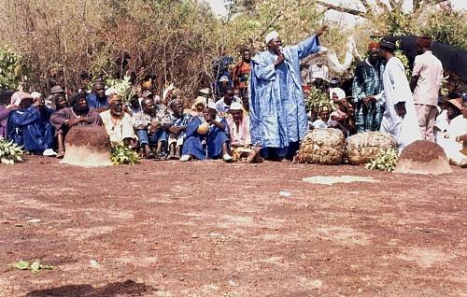
Culture – essential for peace
Manden Charter, Mali
© DNPC

Slide 11
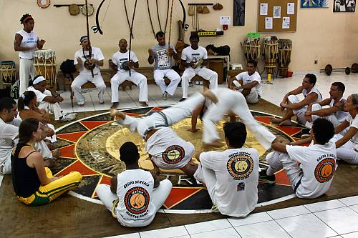
Envisaging culture as a lever and driving force for development
Capoeira circle
© 2012 by TT Catalão / IPHAN

Slide 12
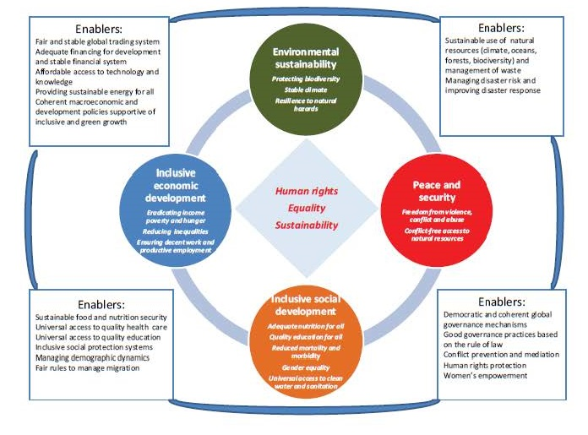
Enablers for implementing the 2030 Agenda
Recognizing cultural diversity and
the contribution of cultures

Slide 13
Culture in the objectives of the 2030 Agenda
1. End poverty in all its forms everywhere
2. End hunger, achieve food security, improve nutrition and promote sustainable agriculture
3. Ensure healthy lives and promote well-being for all at all ages
4. Ensure inclusive and equitable quality education and promote lifelong learning opportunities for all
5. Achieve gender equality and empower all women and girls
6. Ensure availability and sustainable management of water and sanitation for all
7. Ensure access to affordable, reliable, sustainable and modern energy for all
8. Promote sustained, inclusive and sustainable economic growth, full and productive employment and decent work for all
9. Build resilient infrastructure, promote inclusive and sustainable industrialization and foster innovation

Slide 14
Culture in the objectives of the 2030 Agenda (2)
10. Reduce inequality within and among countries
11. Make cities and human settlements inclusive, safe, resilient and sustainable
12. Ensure sustainable consumption and production patterns
13. Take urgent action to combat climate change and its impacts
14. Conserve and sustainably use the oceans, seas and marine resources for sustainable development
15. Protect, restore and promote sustainable use of terrestrial ecosystems, etc.
16. Promote peaceful and inclusive societies for sustainable development, provide access to justice for all and build effective, accountable and inclusive institutions at all levels
17. Strengthen the means of implementation and revitalize the Global Partnership for Sustainable Development

Slide 15
Culture in UNDAFs
A sharp increase in inclusion of culture in UNDAFs:
2006: 30% of UNDAFs
2012: 70% of UNDAFs

Slide 16
Guarantee of sustainable development

Slide 17
Inclusive social development: health
Andean cosmovision of the Kallaway
© Jérôme Tubiana UNESCO

Slide 18
Inclusive social development: Food security
Traditional Mexican cuisine – ancestral, ongoing community culture, the Michoacán paradigm
©2006 A. Rios / Secretara de Turismo del Estado de Michoacán

Slide 19
Inclusive economic development
La Samba de Roda of the Recôncavo of Bahia, Brésil
© Luiz Santos UNESCO

Slide 20
Inclusive economic development
Cultural practices and expressions linked to the balafon of the Senufo communities of Mali, Burkina Faso © 2012 by Direction du Patrimoine Culturel

Slide 21
Peace and security – Conflict resolution
Irrigators’ tribunals of the Spanish Mediterranean coast: the Council of Wise Men of the plain of Murcia and the Water Tribunal of the plain of Valencia
©2005 by Generalitat Valenciana

Slide 22
Exercise 2: Examples
Analysis of ICH and sustainable development case studies
90 minutes

Slide 23
Safeguarding is essential
if communities across the world are to make the changes ‘needed to shift the world on to a sustainable path’
if we want to find innovative, culturally sensitive solutions to the challenges posed by development
if we want to ensure the well-being of all

Slide 24
Exercise 3: Risks
Risks to the viability of intangible cultural heritage in the context of safeguarding strategies
1 hour

Slide 25
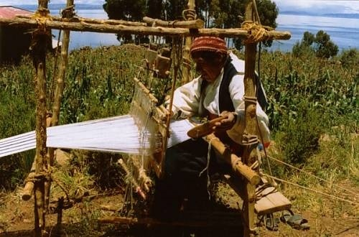
Case study: textile art in Taquile (Peru) – tourism and trade
Weaving in Taquile
© Instituto Nacional de Cultura / Dante Villafuerte

Slide 26
Case study: commercialization of traditional knowledge regarding Hoodia gordonii as an appetite suppressant (South Africa and Namibia)
The Hoodia gordonii
© Martin Heigan

Slide 27
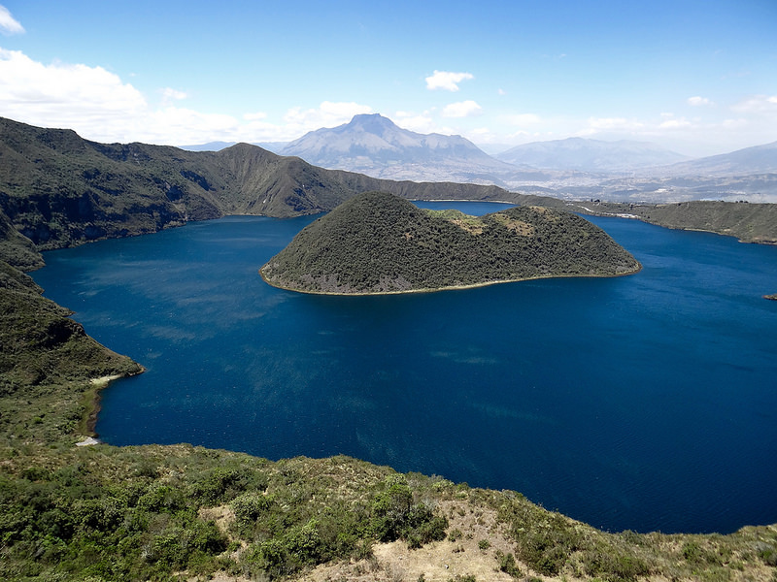
Case study: Runa Tupari tourism project (Ecuador)
‘Lac du cratère Cuicocha (3 246 m) - Volcan/Caldeira d'Équateur’ by ffigon is licensed under CC BY-SA 2.0

Slide 28
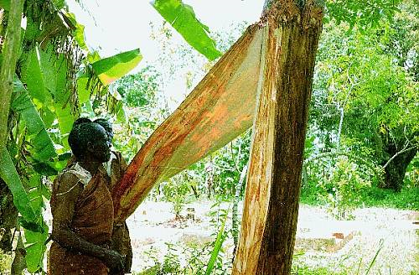
Case study: Ugandan bark cloth
Removing bark for making bark cloth
© J. K. Walusimbi

Slide 29
Income-generating opportunities created by safeguarding activities
Tourism
Use of traditional knowledge to manage environmental resources in a sustainable way for the purpose of profit
Use of traditional knowledge for new purposes
Introduction of relevant products and practices from traditional medicine into the health system
Sale of handicrafts
ICH performances with admission fees
Festivals
Competitions
Corporate sponsorship

Slide 30
Risks
ICH freezing (discontinuation)
Loss of purpose and meaning
Decontextualization
Misrepresentation
Misappropriation
Unequal income distribution
Overexploitation of natural resources
Unrealistic expectations
Lack of dialog, leading to over-involvement of institutional mechanisms
Commercialization

Slide 31
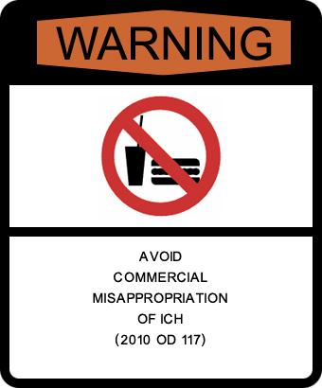
WARNING:
Avoid over-commercialization and unsustainable tourism (OD 102)

Slide 32
WARNING:
Commercial activities (...) and trade should not threaten the viability of the ICH (OD 116)

Slide 33
WARNING:
Avoid distorting the meaning and purpose of the ICH for the communities concerned (OD 117)

Slide 34
Mitigating risks with the help of...
The participation and consent of the communities
Capacity building
Consultation mechanisms
Risk evaluation and strategic solutions
Legal frameworks for protecting the rights of communities

Slide 35
A mutual relationship between safeguarding and development policies
The image of the snake that bites its own tail
If the world is unable to bring about truly sustainable development, ICH will remain at risk;
but if ICH is not safeguarded, it will be impossible to make sustainable development a reality.
A new Operational Directives chapter
is currently being drawn up

