Slide 1
Who can do what in implementing the Convention?
Case Study 1: Yamahoko Float Ceremony

Slide 2
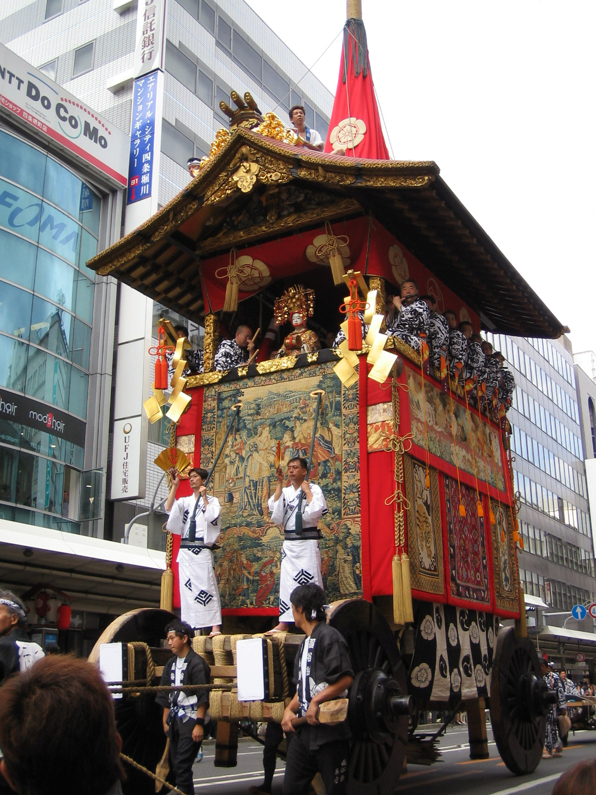
Yamahoko float ceremony, Kyoto Gion festival (Japan)
The float procession in the streets of Kyoto
Inscribed in 2016 on the Representative List of the Intangible Cultural Heritage of Humanity as part of the file 'Yama, Hoko, Yatai, float festivals in Japan'
A float decorated with tapestries is pulled through the streets while people in the floats play festival music (Kyoto Gion festival)
© Agency for Cultural Affairs, Japan, 2015

Slide 3
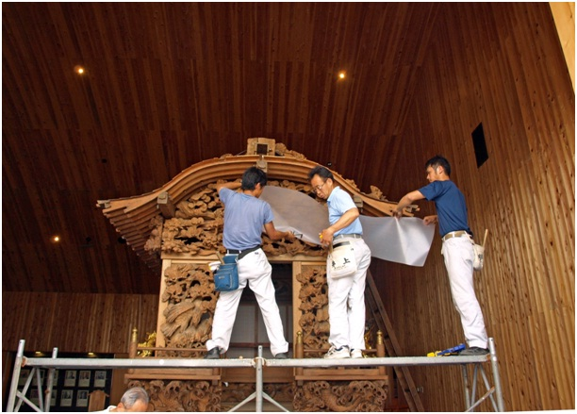
Yamahoko float ceremony: community-led activities (1)
Craftsmen work together to preserve and repair a float decorated with wooden carvings
© Agency for Cultural Affairs, Japan, 2015

Slide 4
Yamahoko float ceremony: community-led activities (2)
Local residents participate by attending, pulling floats, playing music and performing various preparatory tasks as members of residents’ associations that are responsible for the different floats
The Foundation for Gion Festival Preservation Associations coordinates activities

Slide 5
Yamahoko float ceremony: government support
Municipal government helps with logistics
Provincial (prefectural) government funds and supports
National government funds and creates legislative structures

Slide 6
Yamahoko float ceremony: other stakeholders (1)
Local weaving and metalworking firms repair and replace necessary objects
National Research Institute and universities undertake research

Slide 7
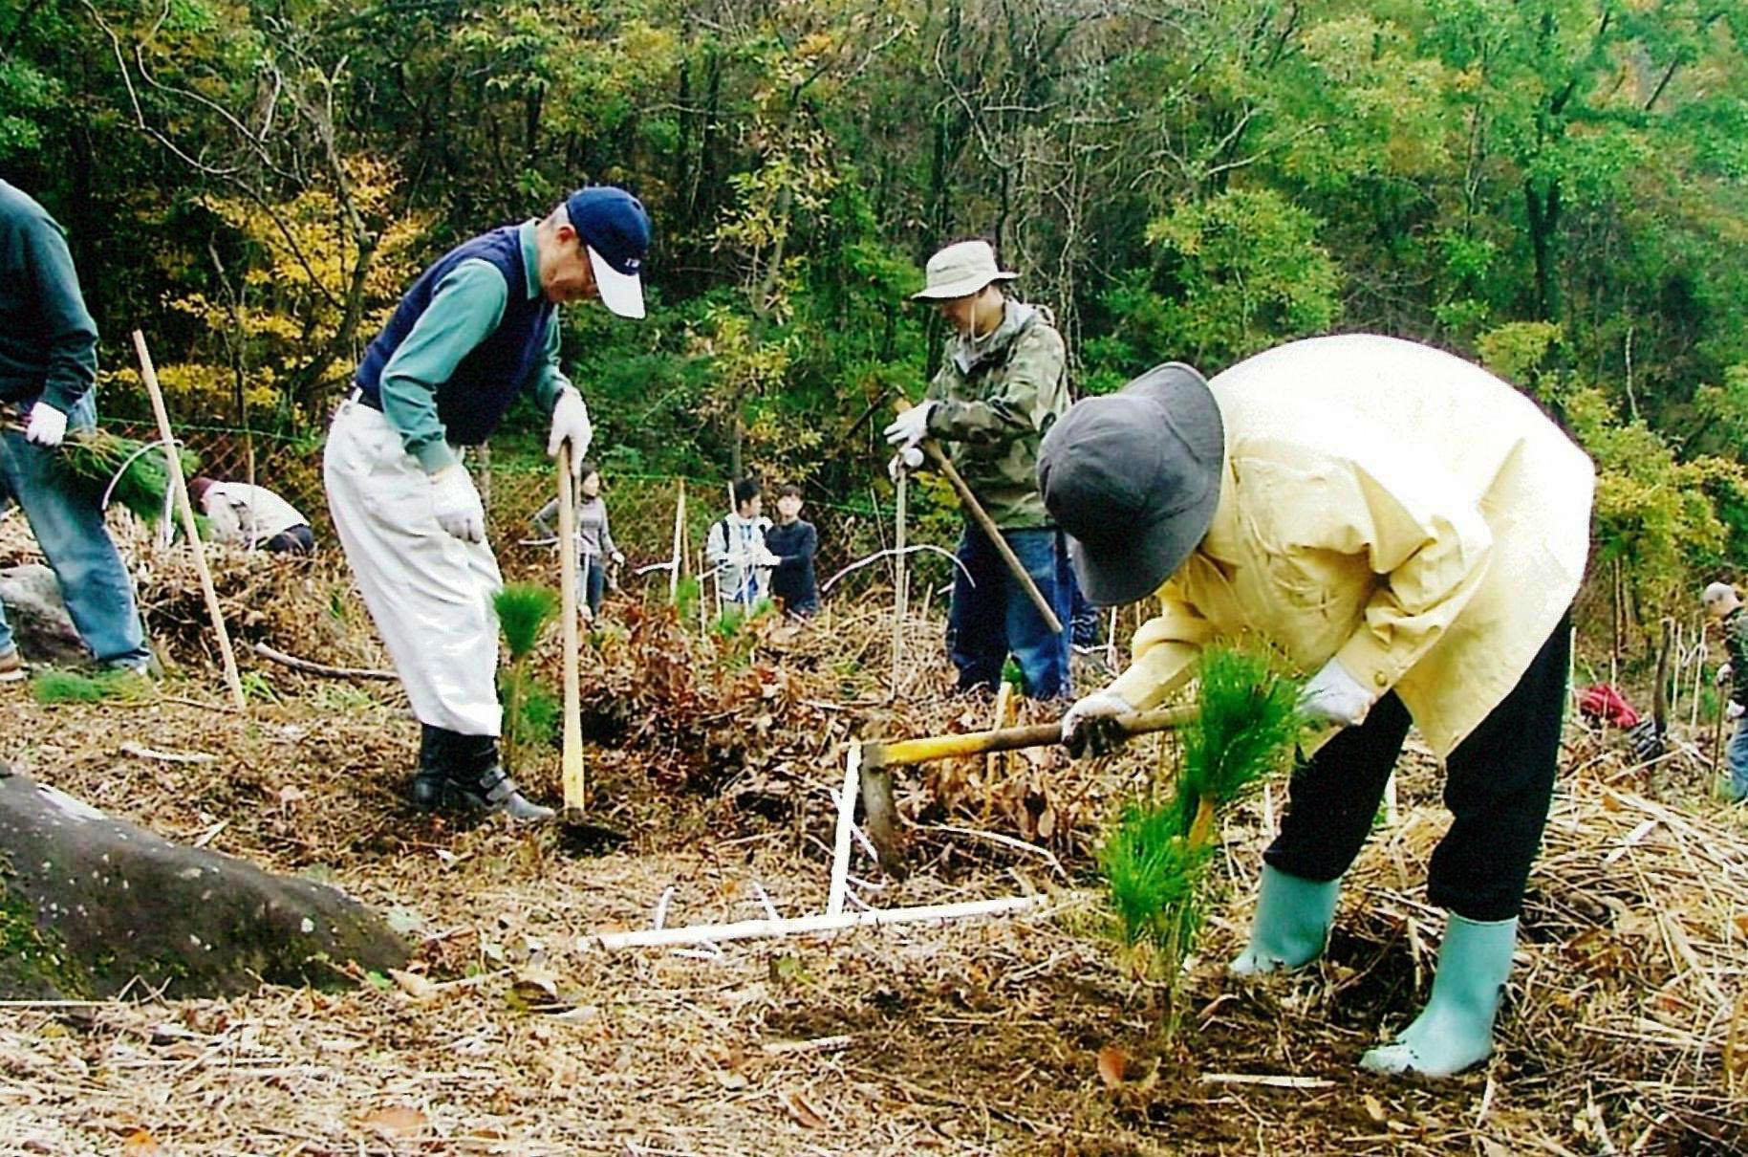
Yamahoko float ceremony: other stakeholders (2)
Community members plant red pine saplings to secure future materials used for the floats in a sustainable manner
© Agency for Cultural Affairs, Japan, 2015

Slide 8
Published in 2024 by the United Nations Educational, Scientific and Cultural Organization,7, place de Fontenoy, 75352 Paris 07 SP, France
© UNESCO 2024
This publication is available in Open Access under the Attribution-ShareAlike 3.0 IGO (CC-BY-SA 3.0 IGO) license (http://creativecommons.org/licenses/by-sa/3.0/go ). By using the content of this publication, the users accept to be bound by the terms of use of the UNESCO Open Access Repository (http://www.unesco.org/open-access/terms-use-ccbysa-en).
The images of this publication do not fall under the CC-BY-SA licence and may not be used, reproduced, or commercialized without the prior permission of the copyright holders.
The designations employed and the presentation of material throughout this publication do not imply the expression of any opinion whatsoever on the part of UNESCO concerning the legal status of any country, territory, city or area or of its authorities, or concerning the delimitation of its frontiers or boundaries.
The ideas and opinions expressed in this publication are those of the authors; they are not necessarily those of UNESCO and do not commit the Organization.

