Slide 1
19.COM 1.BUR
Bureau of the nineteenth session of the Intergovernmental Committee
for the Safeguarding of the Intangible Cultural Heritage
UNESCO Headquarters, Room VI
5 March 2024 (10 a.m. to 1 p.m.)

Slide 2
19.COM 1.BUR
Item 2: Adoption of the agenda
Document: LHE/24/19.COM 1.BUR/2

Slide 3
19.COM 1.BUR
Item 3: Examination of an emergency request for International Assistance
Document: LHE/24/19.COM 1.BUR/3

Slide 4
International Assistance (status as of 1 March 2024)

Slide 5
Criteria for International Assistance
A.1: The community, group and/or individuals concerned participated in the preparation of the request and will be involved in the implementation of the proposed activities, and in their evaluation and follow-up as broadly as possible.
A.2: The amount of assistance requested is appropriate.
A.3: The proposed activities are well conceived and feasible.
A.4: The project may have lasting results.
A.5: The beneficiary State Party shares the cost of the activities.
A.6: The assistance aims at building up or reinforcing capacities in the field of safeguarding intangible cultural heritage.
A.7: The beneficiary State Party has implemented previously financed activities, if any, in line with all regulations and any conditions applied thereto.

Slide 6
Additional considerations for International Assistance
10(a): The request implies cooperation at the bilateral, regional or international levels;
10(b): The assistance may have a multiplier effect and may stimulate financial and technical contributions from other sources.

Slide 7
19.COM 1.BUR
Item 4: Examination of requests for International Assistance up to US$100,000
Document: LHE/24/19.COM 1.BUR/4

Slide 8
19.COM 1.BUR
Item 5: Other business

Slide 9
https://ich.unesco.org/en/schedule-of-statutory-meetings-in-2024-01334

Slide 10
Evaluation Body (2024 cycle)
Chairperson: Mr Kirk Siang Yeo (Singapore)
Vice-Chairperson: Ms Evrim Ölçer Özünel (Türkiye)
Rapporteur: Ms Barbra Babweteera Mutambi (The Cross-Cultural Foundation of Uganda)

Slide 11
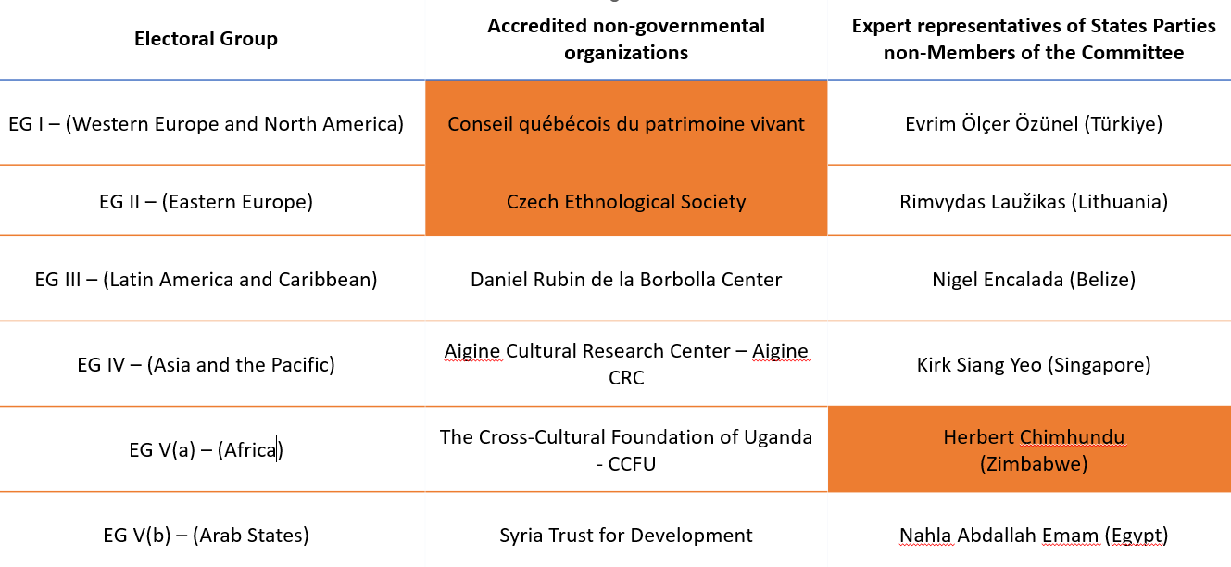
Composition of the 2024 Evaluation Body

Slide 12
Overview of files to be evaluated (2024 Cycle)
68 files | 2 Urgent Safeguarding List
 | 60 Representative List (including 6 extensions)
 | 3 Register of Good Safeguarding Practices
 | 3 Transfer requests from USL to RL
17 Multinationals
51 Nationals

Slide 13

https://ich.unesco.org/en/news/deadline-for-the-2025-cycle-nominations-2-april-2024-13513

Slide 14
ICH.nominations@unesco.org

