Slide 1
NINTH Annual Coordination Meeting of category 2 centres active in the field of intangible cultural heritage
29 November 2021

Slide 2
Latest developments in the life of the 2003 convention

Slide 3
Medium-Term Strategy (41 C/4) and the Programme and Budget (41 C/5)
Adopted at the 41st session of the General Conference (9-24 November 2021)
One dedicated output:
OP5.CLT4 “Member States and communities capacities strengthened to identify, safeguard and promote living heritage”
Contributes to three outcomes (stronger intersectoral focus):
Outcome 5 “Enhance the protection and promotion of the diversity of heritage and cultural expressions”,
Outcome 1 “Advance inclusive quality education and lifelong learning opportunities for all” and
Outcome 3 “Enhance knowledge for climate action, respect for biodiversity, water and ocean management, and disaster risk reduction”
… and enhance capacity building and the participation of Indigenous Peoples and youth in the safeguarding and transmission of living heritage

Slide 4
Evaluation by the UNESCO Internal Oversight Service
Key findings (among others):
Priority given to listing mechanisms over other operational activities
Partners, such as C2Cs, have extended the outreach of the CAP programme
Changing context, new themes and increasing demand require programme reorientation and expansion;
Specific recommendation on the category 2 centres – further intensify exchange
Available online at https://ich.unesco.org/en/16com

Slide 5
Two main funding priorities for 2022-2025
Cat 2 centres are key partners – thank you!
Expand the geographical and thematic scope Strengthen facilitators network Strategic reorientation towards a multi-modal delivery approach (hybrid, in-person, and fully online formats) | Scaling up : strong inter-ministerial collaboration and policy development at all levels combined with community-based approaches

Slide 6
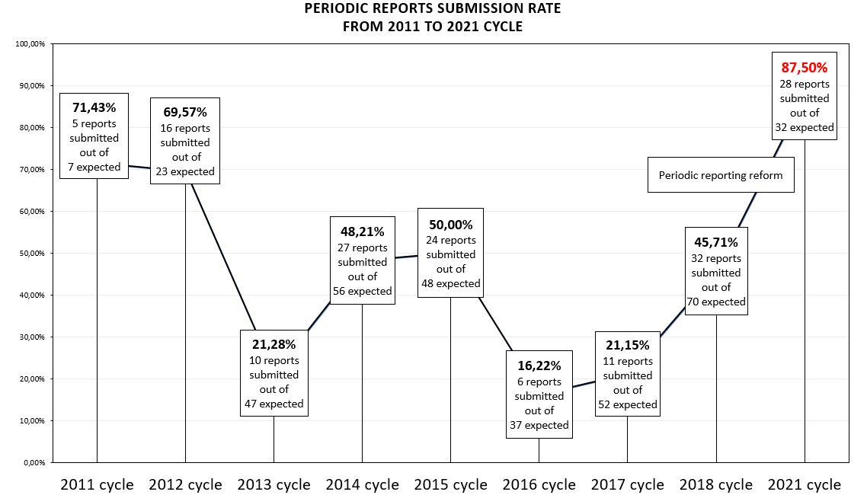
Periodic reporting – first results of the reform
Cat2 centres key partners for CAP – thank you !

Slide 7
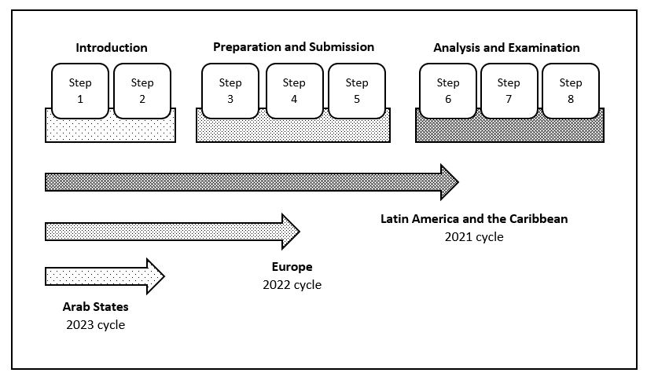
Periodic reporting – current status
2024 cycle: Africa
2025 cycle: Asia and the Pacific
2026: Reflection year
Capacity-building approach extends from Step 1 to 4

Slide 8
Questions and answers

Slide 9
UPCOMING RENEWAL EVALUATIONS

Slide 10
Renewal evaluation process
UNESCO reminds the C2C and the Member State(s) concerned of the impending termination of the Agreement
Member State submits a request for renewal of the agreement - 24 to 36 months prior to the expiration of the agreement
RENEWAL EVALUATION PROCESS
reception of the funds, selection of evaluation team, evaluation
completion 2 months before the meeting of Intersectoral Review Committee
Assessment by UNESCO Intersectoral Review Committee
in April for autumn session of the UNESCO Executive Board, in October – for spring session of the Board
Examination of the results of evaluation by the Executive Board
(autumn or spring session)
If the Executive Board agrees to renew, UNESCO DG is authorized to sign agreement

Slide 11
Current agreements and upcoming evaluations
Category 2 centre in the field of ICH | Agreement |  |  | Next evaluation
 | Latest agreement singed on | Date of entry into force | Date of expiry | Evaluation to happen | Target session of Intersectoral review Committee | Session of the UNESCO Executive Board examining the evaluation
CRESPIAF | 28 February 2014 | 10 February 2016 | 31 December 2022 | 2022 | April 2022 | Autumn session in 2022
Sofia Centre | 10 November 2017 | 14 June 2018 | 13 June 2024 | 2023 | October 2023 | Spring session in 2024
CRIHAP | 16 August 2018 | 16 August 2018 | 15 August 2024 | 2023 | October 2023 | Spring session in 2024
Tehran Centre | 28 April 2010 | 8 November 2012 | Expired on 31/12/2019 – new agreement was signed and is in process of entry into force | - | - | -
IRCI | 6 December 2018 | 6 December 2018 | 5 December 2024 | 2023 | October 2023 | Spring session in 2024
CRESPIAL | 21 July 2014 | 22 January 2015 | 31 December 2022 | New agreement and a MoU are being finalized
ICHCAP | 11 October 2019 | 3 December 2019 | 2 December 2025 | 2024 | October 2024 | Spring session in 2025
Sharjah Centre | Established by the UNESCO General Conference in 2019. Agreement to be signed soon.

Slide 12
Questions and answers

Slide 13
Exchange session on future plans and priorities
Capacity building
Networking
Research
Living Heritage and education
Other

