Slide 1
Eighth Annual Coordination Meeting of category 2 centres active in the field of intangible cultural heritage
30 November 2020

Slide 2
Structure of the meeting
Updates on latest developments
Strategy for category 2 institutes and centres under the auspices of UNESCO
Working in the context of the COVID-19 pandemic and post-pandemic
Questions and answers, closing

Slide 3
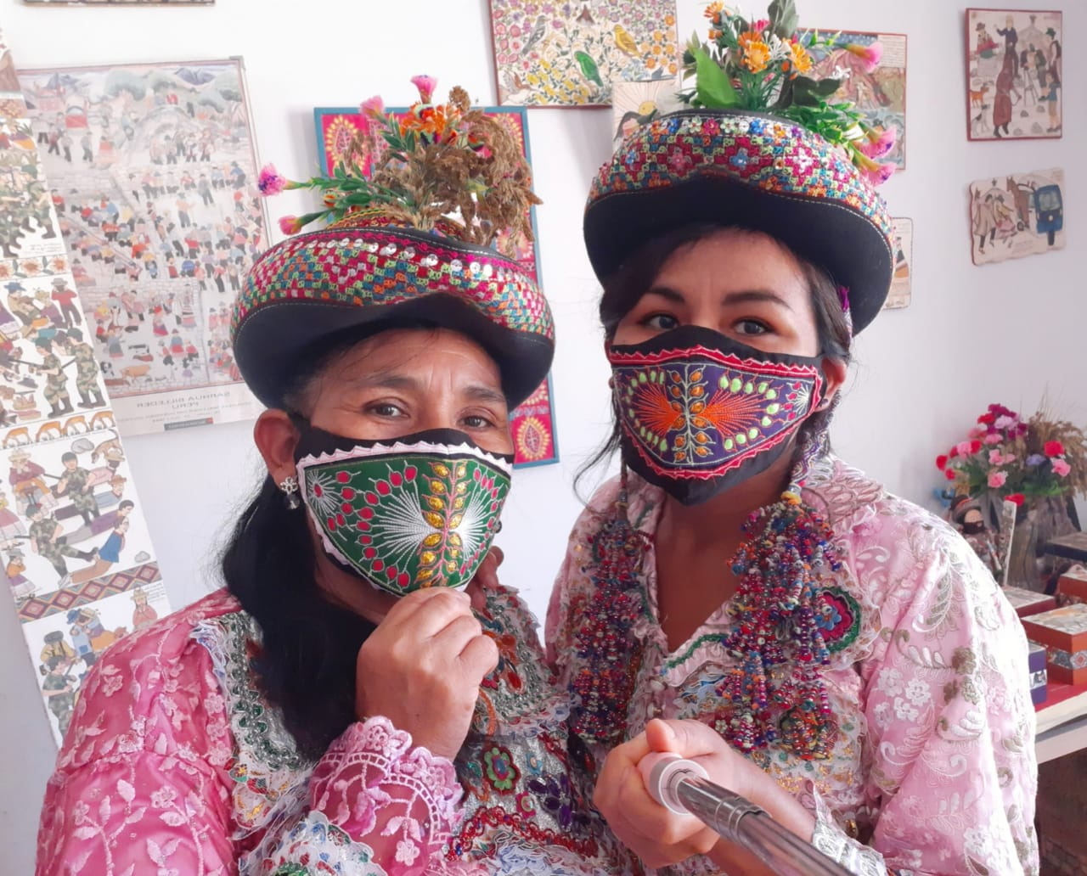
Impact of the COVID-19 pandemic
Response from the Living Heritage Entity:
Adapting modalities and working methods in the context of the pandemic
Statutory meetings, expert meetings, capacity-building activities adapted to online format
Survey and dedicated web-platform, online debate on ‘Living heritage experiences and the COVID-19 pandemic’
Capacity-building materials and knowledge management tools available in open access

Slide 4
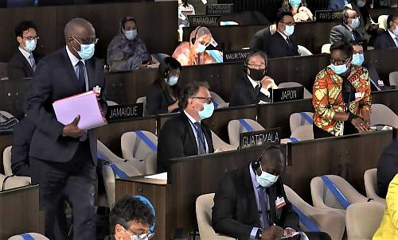
Latest developments
180 States Parties with Angola and Somalia joining
8th session of the General Assembly, 8-10 September 2020
Operational principles and modalities for safeguarding ICH in emergencies
Reflection on listing mechanisms
15th session of the Intergovernmental Committee to be held fully online (14-19 December 2020, with one three-hour session per day

Slide 5
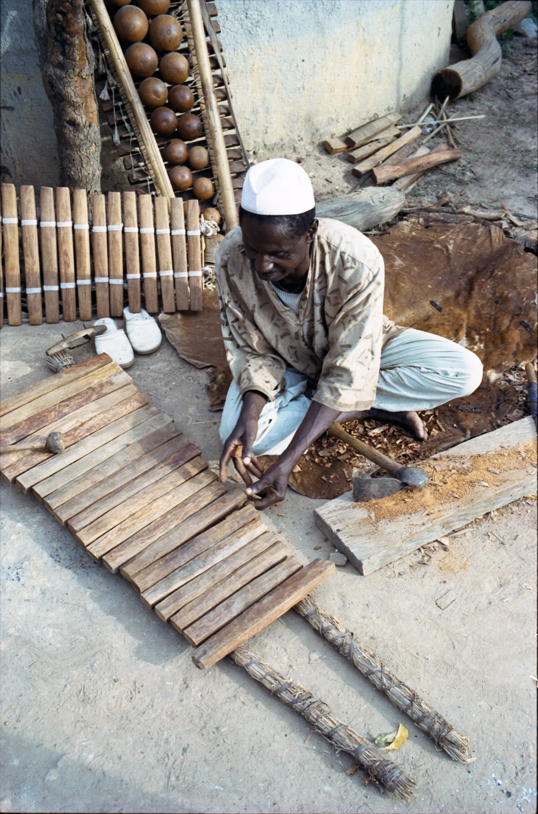
Capacity building
Since 2018, 118 countries benefitted from capacity building, including the activities in 40 countries supported by category 2 centres
Work on capacity-building approach in the context of emergencies (conflicts and natural disasters); research undertaken by IRCI
Interregional working group for the facilitators network operational and training for trainers workshops in Africa, Europe and Central Asia (with CRESPIAF, Sofia Centre and CRIHAP)
Networking among universities now global (with CRESPIAL, Sofia Centre, ICHCAP and CRIHAP)

Slide 6

Living heritage in education
Projects to pilot approaches and develop guidance in Asia and the Pacific (with ICHCAP), Europe, Latin America and the Caribbean
Clearinghouse with examples and resources ready to be launched (we will notify you)
Expert meeting on education-related indicators in the ORF of the Convention and SDG4 (with ICHCAP)
Massive Open Online Course (with ICHCAP)

Slide 7
Implementing the periodic reporting reform
States Parties submit their report on the implementation of the 2003 Convention every six years based on a system of regional rotation
Calendar established by the Committee:
  2020: Latin America and the Caribbean
  2021: Europe
  2022: Arab States
  2023: Africa
  2024: Asia and the Pacific
  2025: Reflection year

Slide 8

Periodic reporting: initial experiences
2020: Latin America and the Caribbean (with CRESPIAL)
Re-designing the capacity-building approach for the online format
Online Form ICH-10
26 guidance notes for indicators of the Overall Results Framework
6-week online course for national focal points and facilitators (videos, webinars & online discussion
2021: Europe (with Sofia centre)

Slide 9
Strategy for category 2 institutes and centres under the auspices of UNESCO

Slide 10
Background
Audit of the Management Framework of Category 2 Institutes and Centres in 2017
Some key findings:
  Two-thirds of C2Cs were not in conformity with the Management framework/2013 Strategy
  Exponential growth in number of C2Cs; beyond UNESCO’s reduced capacity to effectively follow-up
  Need for new overarching criteria for institutes/centres
  Improve screening process for proposals and renewals
UNESCO Executive Board requested a management response which resulted in 40th General Conference adopting the 2019 Strategy

Slide 11
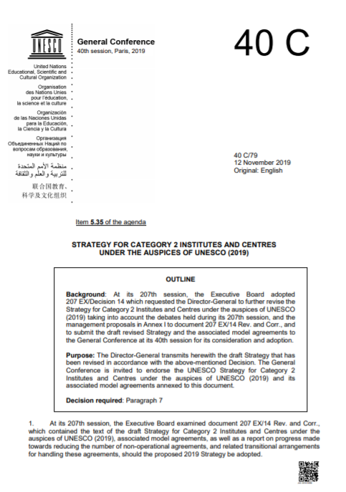
The 2019 category 2 centres strategy
The new Strategy replaced the Integrated Comprehensive Strategy on C2Cs of 2013
Only existing institutions with their own legal personality and 2 years experience in UNESCO’s field of competence are eligible
Renewal evaluation process reviewed.
  Requests for renewals to be submitted by the Member State at least 24-36 months prior to the expiration of the agreement;
  Intersectoral Review Committee

Slide 12
Evaluation process
UNESCO reminds the C2C and the Member State(s) concerned of the impending termination of the Agreement
Member State submits a request for renewal of the agreement - 24 to 36 months prior to the expiration of the agreement
RENEWAL EVALUATION PROCESS
reception of the funds, selection of evaluation team, evaluation
completion 2 months before the meeting of Intersectoral Review Committee
Assessment by UNESCO Intersectoral Review Committee
in April for autumn session of the UNESCO Executive Board, in October – for spring session of the Board
Examination of the results of evaluation by the Executive Board
(autumn or spring session)
If the Executive Board agrees to renew, UNESCO DG is authorized to sign agreement

Slide 13
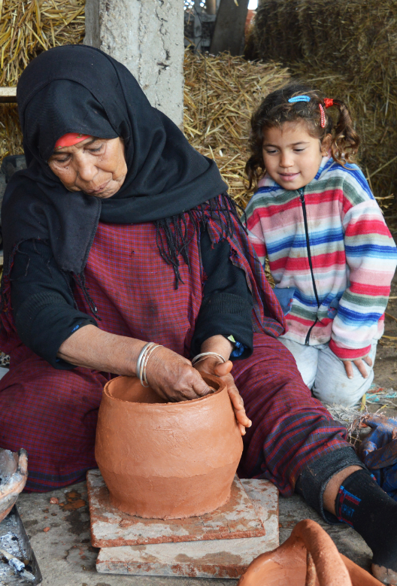
Agreements under the 2019 C2C strategy
The duration of agreements is eight years maximum
Agreements are tripartite - signed by 2 parties and the centre/institute concerned
Annual contribution of $1,000 per centre/institute
Up to two years to sign the agreement after the decision of the UNESCO Executive Board

Slide 14
Reporting
Annual online reporting from C2Cs using a standard template
Deadline – 31 December annually (extended to 15 Feb 2021)
  General information (names, telephone, email, web, etc.)
  Major achievements/ activities – contribution to UNESCO programmes and strategic priorities/ other international development agendas/ SDGs
  Beneficiaries – totals and disaggregated by country, gender, professional grouping
  Partnerships; Challenges; Lessons learned; Future plans
Security note: only the email address receiving the invitation to report can access and make changes to the online report

Slide 15
Current agreements and upcoming evaluations
Category 2 centre in the field of ICH | Agreement |  |  | Next evaluation
 | Latest agreement singed on | Date of entry into force | Date of expiry | Evaluation to happen | Target session of Intersectoral review Committee | Session of the UNESCO Executive Board examining the evaluation
CRESPIAF | 28 February 2014 | 10 February 2016 | 9 February 2022 | 2021 | April 2021 | Autumn session in 2021
Sofia Centre | 10 November 2017 | 14 June 2018 | 13 June 2024 | 2023 | October 2023 | Spring session in 2024
CRIHAP | 16 August 2018 | 16 August 2018 | 15 August 2024 | 2023 | October 2023 | Spring session in 2024
Tehran Centre | 28 April 2010 | 8 November 2012 | Expired on 31/12/2019 – new agreement to be signed | - | - | -
IRCI | 6 December 2018 | 6 December 2018 | 5 December 2024 | 2023 | October 2023 | Spring session in 2024
CRESPIAL | 21 July 2014 | 22 January 2015 | 21 January 2021 (extension ongoing) | ongoing | April 2021 | Autumn session in 2021
ICHCAP | 11 October 2019 | 3 December 2019 | 2 December 2025 | 2024 | October 2024 | Spring session in 2025
Sharjah Centre | Established by the UNESCO General Conference in 2019. Agreement to be signed

Slide 16
COVID-19 pandemic
Category 2 Centres
Working in the context of the COVID-19 pandemic
Implication for work in the post-pandemic period

Slide 17
Eighth Annual Coordination Meeting of category 2 centres active in the field of ICH
Questions and answers

