Slide 1
Seventh Annual Coordination Meeting of category 2 centres active in the field of intangible cultural heritage
Algiers, Algeria, 2-3 September 2019

Slide 2
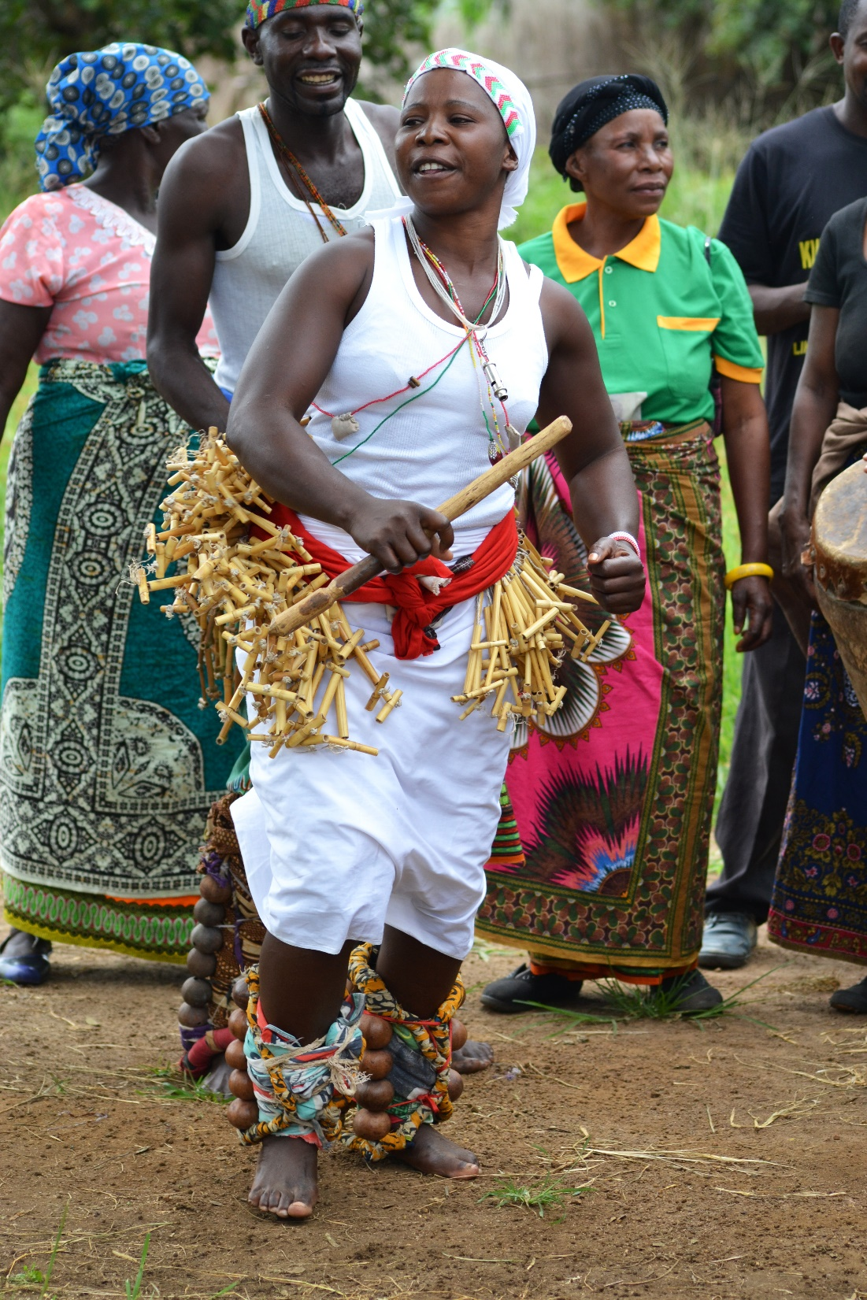
Objectives of the meeting
Presentation and debate on:
Recent developments concerning C2Cs
Recent developments in the life of the 2003 Convention
Two funding priorities
General debate:
Upcoming workplans
Synergies and cooperation amongst the Centres and with UNESCO Secretariat
Current challenges faced by the Centres in implementing the Convention
Seventh Annual Coordination Meeting of C2Cs
Algiers, 2–3 September 2019

Slide 3
Recent developments concerning category 2 centres. Renewals.

Slide 4
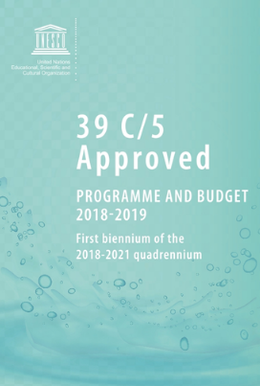
39 C/5 (2018-2021)
Adopted at the 39th session of the General Conference in 2017
Covers the second and final quadrennium of the UNESCO’s Medium-Term Strategy for 2014-2021 (document 37 C/4)
First biennium 2018-2019 (39 C/5) and second biennium 2020-2021 (40 C/5)
Seventh Annual Coordination Meeting of C2Cs
Algiers, 2–3 September 2019

Slide 5
MLA 2: Creativity, Expected result 6
MLA 2
‘Fostering creativity and the diversity of cultural expressions, as well as the safeguarding of intangible cultural heritage for sustainable development’
Expected result 6
Intangible cultural heritage identified and safeguarded by Member States and communities, in particular through the effective implementation of the 2003 Convention
+ Two additional cross-cutting ERs on emergencies and on the 2030 Sustainable Development Agenda
Seventh Annual Coordination Meeting of C2Cs
Algiers, 2–3 September 2019

Slide 6
ER 6, Performance indicators (1)
PI 1: Sound governance exercised through the adoption and implementation of strategic resolutions/decisions of the governing bodies of the 2003 Convention
PI 2: Number of supported Member States utilizing strengthened human and institutional resources for the safeguarding of intangible cultural heritage
PI 3: Number of supported Member States which have integrated intangible cultural heritage into their plans, policies and programmes, in particular as a contribution towards the achievement of SDGs in a gender-responsive manner
Seventh Annual Coordination Meeting of C2Cs
Algiers, 2–3 September 2019

Slide 7
ER 6, Performance indicators (2)
PI 4: Number of States Parties who have effectively implemented international assistance, including from the Intangible Cultural Heritage Fund, complementing their national safeguarding efforts
PI 5: Number of initiatives undertaken by supported Member States which have enhanced knowledge and understanding of intangible cultural heritage safeguarding and of the 2003 Convention
Seventh Annual Coordination Meeting of C2Cs
Algiers, 2–3 September 2019

Slide 8
Current management framework for C2Cs
37 GC/Resolution 93 - Integrated Comprehensive Strategy (2013):
Emphasis on contributions of category 2 centres to:
  strategic programme objectives and global priorities (C/4)
  sectoral or intersectoral programme priorities and themes (C/5)
Agreements for six years, review process and evaluation
Results of evaluations are presented to UNESCO Executive Board that has authority to authorize UNESCO Director-General to sign agreements on C2Cs
Full costs to be borne by category 2 centres and/or host countries
Seventh Annual Coordination Meeting of C2Cs
Algiers, 2–3 September 2019

Slide 9
New Management Framework for C2Cs
A new framework under discussion following the audit of UNESCO Internal Oversight Service on C2Cs (2017)
UNESCO Executive Board discussed the first draft in April 2019. The second draft will be presented to the Board in October 2019;
If adopted by the 40th session of the General Conference this year, will replace the Integrated Comprehensive Strategy on C2Cs of 2013
Seventh Annual Coordination Meeting of C2Cs
Algiers, 2–3 September 2019

Slide 10
New Management Framework for C2Cs (2)
Requests for renewals to be submitted by the Member State concerned at least 24 months prior to the expiration of the agreement;
Renewal assessments are considered by an Intersectoral Review Committee, which will recommend to the Director-General if an agreement should be renewed;
The duration of agreements is proposed to be increased to maximum eight years;
Seventh Annual Coordination Meeting of C2Cs
Algiers, 2–3 September 2019

Slide 11
New Management Framework for C2Cs (3)
Entry in force of agreements on the date of signature;
Annual contribution of $1,000 per centre Agreements are tripartite - signed by 2 parties and the centre/institute concerned
Seventh Annual Coordination Meeting of C2Cs
Algiers, 2–3 September 2019

Slide 12
New Management Framework for C2Cs (4)
Up to two years to sign the agreement after the decision of the UNESCO Executive Board;
Annual reporting from C2Cs to UNESCO and a standard template for such reporting.
Model agreements for establishment and renewal
Seventh Annual Coordination Meeting of C2Cs
Algiers, 2–3 September 2019

Slide 13
New Management Framework for C2Cs (5)
C2Cs whose renewal processes have started prior to the decision of the 40th session of the General Conference on the 2019 strategy, will have their agreements renewed according to the current 2013 Strategy.
C2Cs whose renewal process is due to be launched after the 40th session of the General Conference, will have their agreements renewed in accordance with the 2019 strategy, as adopted by the General Conference.
Seventh Annual Coordination Meeting of C2Cs
Algiers, 2–3 September 2019

Slide 14
Status of agreements and upcoming renewals
C2C | Agreement |  |  | Next renewal
 | Latest agreement singed on | Date of entry into force | Date of expiry | Evaluation to happen | Session of the UNESCO Executive Board that will examine the evaluation
CRESPIAF | 28 February 2014 | 10 February 2016 | 10 February 2022 | 2021 | Autumn session in 2021
Sofia Centre | 10 November 2017 | 14 June 2018 | 14 June 2024 | 2023 | Spring session in 2024
CRIHAP | 16 August 2018 | 16 August 2018 | 16 August 2024 | 2023 | Spring session in 2024
Tehran Centre | 28 April 2010 | 8 November 2012 | 31 December 2019 (extended by UNESCO Ex. Board) | Finalized in June 2019 | 207 session (autumn) session in 2019
ICHCAP | Agreement to be signed in 2019 | - | - | - | -
IRCI | 6 December 2018 | 6 December 2018 | 6 December 2024 | 2023-early 2024 | Autumn session in 2024
CRESPIAL | 21 July 2014 | 22 January 2015 | 22 January 2021 | First half of 2020 | Autumn session of EXB in 2020
Seventh Annual Coordination Meeting of C2Cs
Algiers, 2–3 September 2019

Slide 15
Recent developments in the life of the 2003 Convention

Slide 16
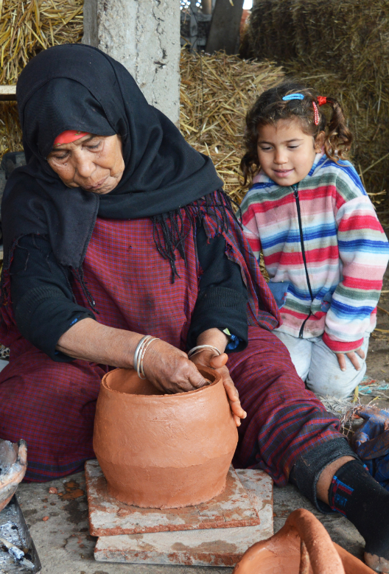
13.COM, Port Louis, Mauritius 2018
  Reform of the periodic reporting mechanism
  Follow-up of inscribed elements on the Lists of the Convention
  Reflection on the participation of NGOs in the implementation of the Convention
  Intangible cultural heritage in emergencies
Seventh Annual Coordination Meeting of C2Cs
Algiers, 2–3 September 2019

Slide 17
Overall results framework
Approved by 7.GA in 2018
Making periodic reporting process a learning opportunity for States Parties to take stock periodically of their own achievements and challenges and to define or redefine their national priorities for safeguarding ICH
8 thematic areas
26 core indicators
86 assessment factors
Thematic Areas | Institutional and human capacities | Transmission and education | Inventorying and research | Policies as well as legal and administrative measures | Role of intangible cultural heritage and its safeguarding in society | Awareness raising | Engagement of communities, groups and individuals as well as other stakeholders | International engagement
Seventh Annual Coordination Meeting of C2Cs
Algiers, 2–3 September 2019

Slide 18
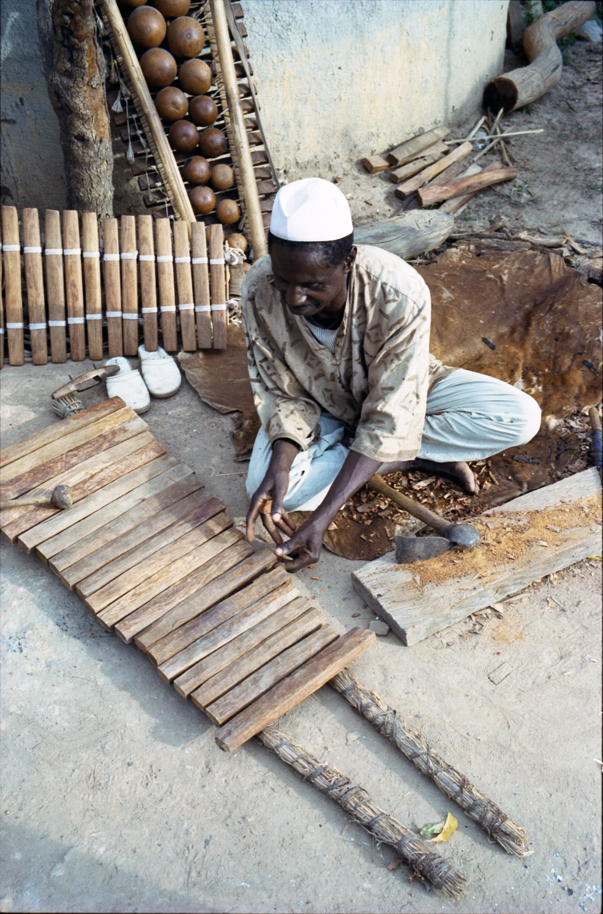
Reform of the periodic reporting mechanism (1)
States Parties submit their report on the implementation of the 2003 Convention every six years based on a system of regional rotation
The Committee (2019) established the calendar for the first regional cycle of national reporting in the following sequence:
  2020: Latin America and the Caribbean
  2021: Europe
  2022: Arab States
  2023: Africa
  2024: Asia and the Pacific
  2025: Reflection year
Seventh Annual Coordination Meeting of C2Cs
Algiers, 2–3 September 2019

Slide 19
Reform of the periodic reporting mechanism (2)
The ICH-10 Form currently being aligned to ensure that the information solicited contributes to the overall results framework;
Guidance Notes and Capacity building materials are being developed to assist states in the implementation of the Overall results framework as well as in periodic reporting
Seventh Annual Coordination Meeting of C2Cs
Algiers, 2–3 September 2019

Slide 20
Reform of the periodic reporting mechanism (3)
Regional introductory workshops
Sub-regional or national working sessions
      How to establish national baselines
      How to involve non-State actors and integrate complementary information
Individual consultation
Seventh Annual Coordination Meeting of C2Cs
Algiers, 2–3 September 2019

Slide 21
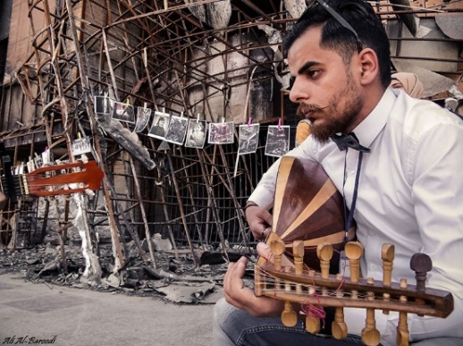
ICH and emergencies. Experiences so far.
      Sample survey with displaced Syrians (2016)
      Community-based needs identification in Nord-Kivu (Democratic Republic of Congo) (2017)
      Emergency Project for the reintegration of ex-combattants in Colombia using ICH as a basis for reconciliation (July 2018)
      Desk study on Safeguarding and Mobilising ICH in the Context of Natural and Human-induced Hazards (Sept 2017)
      Brainstorming meeting on ICH and emergencies, Beirut, October 2018
      Cooperation between UNESCO and UNHCR in mapping cultural resources of displaced Syrians in North Lebanon (June-September 2019)
Seventh Annual Coordination Meeting of C2Cs
Algiers, 2–3 September 2019

Slide 22
Expert meeting on ICH and emergencies, 2019
Committee requested to organize an expert meeting on ICH in emergencies in 2019;
“To conceptualize and transform the knowledge and experience acquired into methodological guidance for States Parties, or for any other relevant national or international stakeholders.’ (Decision 13.COM 11).
The expert meeting was held on 21-22 May 2019
  20 experts from different regions
  Operational principles and modalities under preparation
  Outcomes to be presented at 14.COM in December 2019
Seventh Annual Coordination Meeting of C2Cs
Algiers, 2–3 September 2019

Slide 23
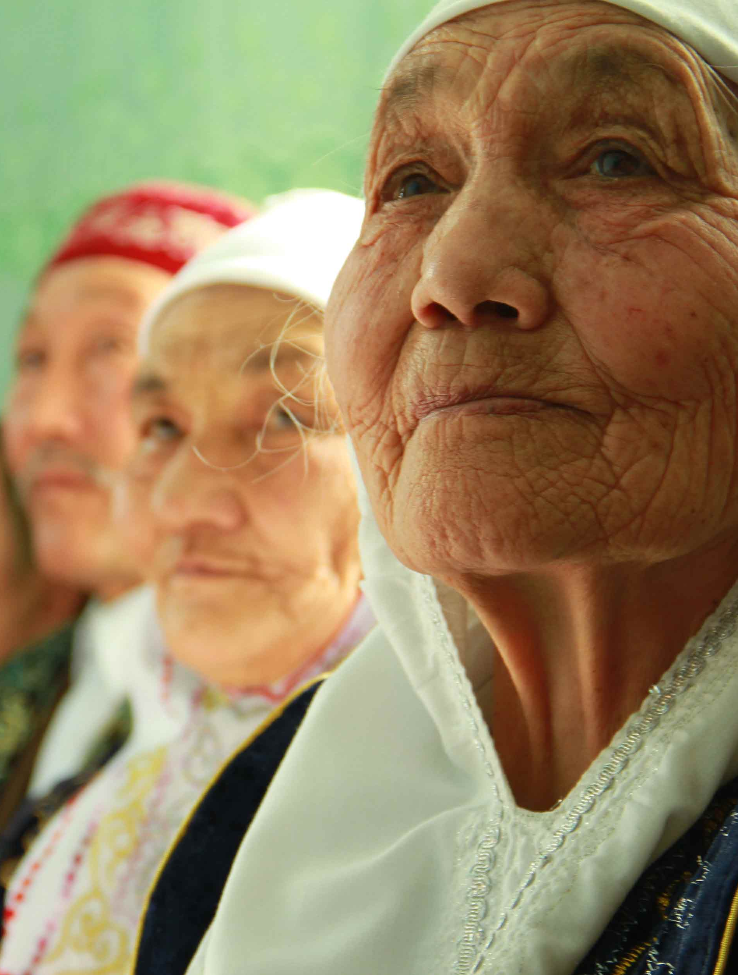
ICH and emergencies.
      Dual approach:
        the impact of emergencies on ICH;
        ICH as a tool for preparedness, recovery and reconciliation
        CAP materials are being prepared on disaster risk reduction and ICH, and integrating disaster risk reduction into inventorying of ICH
        Experiences from C2Cs…
Seventh Annual Coordination Meeting of C2Cs
Algiers, 2–3 September 2019

Slide 24
The role of NGOs (1)
Challenges
Lack of clear definition of inter alia advisory functions
Assymetry of criteria applied in accreditation and review processes
Imbalance in geographical representation
Workload of the governing bodies and of the Secretariat
Other issues to be considered
Regular increase in the number of accredited NGOs
Diversity of profiles and expertise among accredited NGOs
Role of the ICH NGO Forum
Seventh Annual Coordination Meeting of C2Cs
Algiers, 2–3 September 2019

Slide 25

The role of NGOs (2)
Consultation meeting on the Role of accredited NGOs under the 2003 Convention (18 April, 2019)
  Towards a revision of the accreditation process?
  Relation between the Committee and accredited NGOs
  Relations between States and accredited NGOs
Results to be presented to 14.COM in December 2019
Support to NGOs from C2Cs…
Seventh Annual Coordination Meeting of C2Cs
Algiers, 2–3 September 2019

Slide 26
Important meetings in 2019
Statutory meetings
Consultation meeting on the Role of accredited NGOs under the 2003 Convention (18 April, 2019)
Expert meeting on ICH in Emergencies (21-22 May 2019)
14.COM in Bogotá, Colombia, from 9 to 14 December 2019
Capacity-building activities (Trainings of trainers)
Central Asia – 8-12 April 2019, with support of CRIHAP
Africa – 9-13 July 2019, with support of CRESPIAF
Europe – 1-3 October, 2019, with support of the Sofia Centre
Arab States – 4-8 November 2019
Seventh Annual Coordination Meeting of C2Cs
Algiers, 2–3 September 2019

Slide 27
Funding priorities of the 2003 Convention

Slide 28
Two funding priorities
Priority 1
Strengthening capacities to safeguard intangible cultural heritage and contribute to sustainable development
Priority 2
Safeguarding intangible cultural heritage in formal and non-formal education
Seventh Annual Coordination Meeting of C2Cs
Algiers, 2–3 September 2019

Slide 29
Priority 1. Capacity building.
Focus on:
DEVELOPING community-based inventorying and safeguarding methods
SUPPORTING the ability of States to effectively implement the Convention
INTEGRATING the safeguarding of intangible cultural heritage into sustainable development plans, policies and programmes at all levels
STRENGTHENING institutional frameworks to help safeguard intangible cultural heritage
ENHANCING monitoring for the implementation of the Convention
Seventh Annual Coordination Meeting of C2Cs
Algiers, 2–3 September 2019

Slide 30
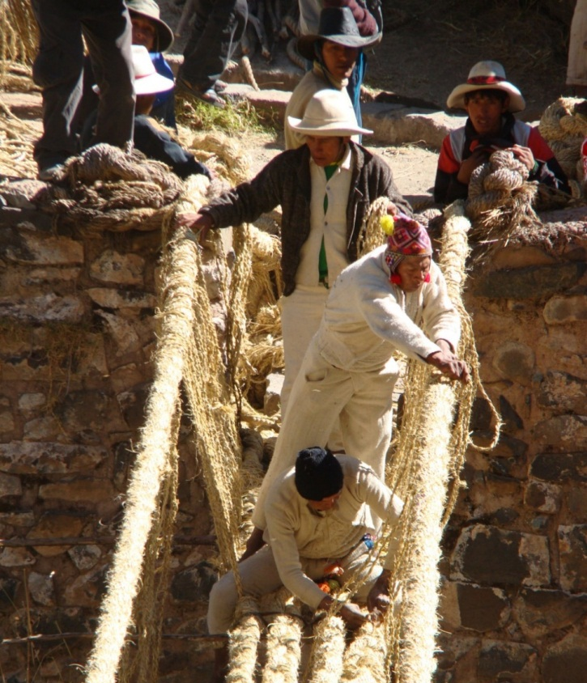
Capacity building: four axes
  Content and materials
  Network of facilitators
  Delivery at country level
  Monitoring and evaluation
Seventh Annual Coordination Meeting of C2Cs
Algiers, 2–3 September 2019

Slide 31
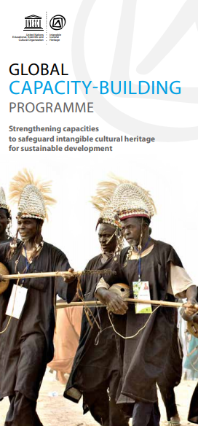
Priority 1. Capacity building.
What is new?
Building national networks of trainers
Stronger partnerships with relevant institutions at national level
Seventh Annual Coordination Meeting of C2Cs
Algiers, 2–3 September 2019

Slide 32

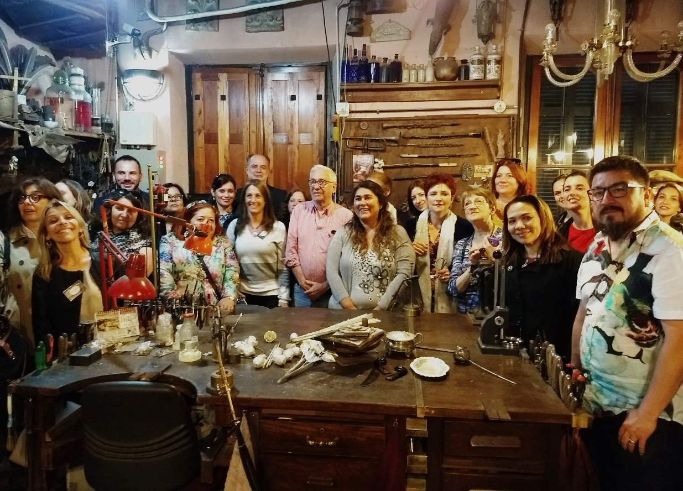
Higher education networking
Higher education institutions are training future decision-makers, planners and administrators
Teaching about ICH is highly dispersed throughout different disciplines
Undertaking surveys and encouraging networking activities in different regions
Seventh Annual Coordination Meeting of C2Cs
Algiers, 2–3 September 2019
Notes:
Higher Education Networking
Tertiary education institutions play an important role in training future decision-makers, planners and administrators to work in the field of safeguarding intangible cultural heritage and can be key actors in capacity-building. Currently, teaching about intangible cultural heritage is highly dispersed throughout different disciplines (heritage studies, anthropology, environment, etc.) and very few programmes training professionals are focused on intangible cultural heritage safeguarding.
Through networking, universities can exchange on different approaches to enrich their own programmes and better understand how to integrate intangible heritage effectively. This is why the Global Capacity-building Programme is working on tertiary education networking.
In addition, the Secretariat of the Convention also collaborates with universities through the UNITWIN/UNESCO Chairs Programme. So far seven UNESCO Chairs related to intangible cultural heritage have been established.
Asia and the Pacific
In 2017, UNESCO Bangkok and ICHCAP carried out a survey on activities and needs of tertiary education actors in Asia and the Pacific. Results were presented on 5 December, 2017 at roundtable side event to the 12th session of the Intergovernmental Committee in Jeju, Republic of Korea.
The First Meeting for Asia-Pacific Tertiary Education Network for ICH Safeguarding was held in the Republic of Korea in July 2018. Co-organized by the UNESCO Office in Bangkok and ICHCAP, the meeting brought together universities around the region interested in developing and strengthening ICH-related tertiary education programmes to discuss future collaborations.
Latin America and the Caribbean
In November 2017 UNESCO Montevideo held a Regional Meeting to Seek Mechanisms for Cooperation between the Intangible Cultural Heritage and Higher Education together with the UNESCO Office in Havana and FLACSO Argentina and in cooperation with IESALC (International Institute for Higher Education in Latin America) and CRESPIAL (Regional Centre for the Safeguarding of the Intangible Cultural Heritage of Latin America).
Europe and North America
In Europe, ENCATC (European network on cultural management and policy), in collaboration with UNESCO, is implementing the participation programme project ‘Learning on intangible heritage: building teacher’s capacity for a sustainable future’ to map and analyse ICH related programmes currently offered by tertiary education institutions in Europe.
Africa
In Africa, the UNESCO Regional Office for Southern Africa led a survey on intangible cultural heritage in Southern African universities in 2018. The survey had a very high response rate and found a diversity of programmes related to intangible cultural heritage in Southern Africa.
For further information, please contact ICH-capacity@unesco.org

Slide 33
Capacity building
Recent achievements
Toolbox on Sustainable Development and ICH released
Expanding the network of facilitators in Central Asia and Africa
Feasibility study on sustainability of the CAP programme (ongoing): a stronger role of C2Cs
Ongoing work on developing CAP for emerging priorities (periodic reporting, INV in cities, emergencies, …)
Seventh Annual Coordination Meeting of C2Cs
Algiers, 2–3 September 2019

Slide 34
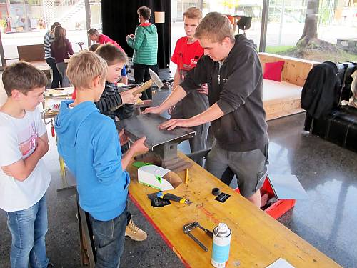
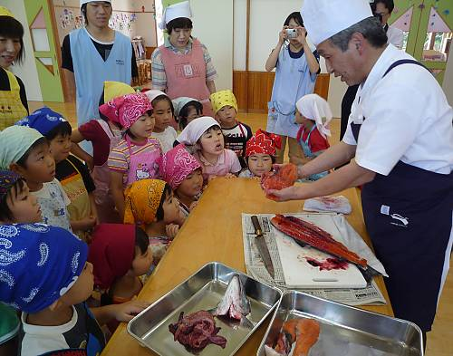
Priority 2 - ICH and education. Context.
Transmission is often interrupted for many reasons, including through education systems
Education is looking for ways to facilitate relevant and meaningful learning and to address development challenges and promote mutual understanding
Thus schools and non-formal education programmes can be places of transmission
Seventh Annual Coordination Meeting of C2Cs
Algiers, 2–3 September 2019

Slide 35
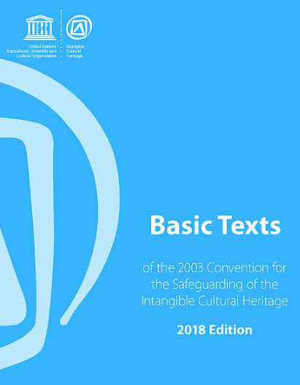

ICH and education
Addresses a key safeguarding measure of the Convention, namely the transmission of intangible cultural heritage ‘through formal and non-formal education’ (see Articles 2.3 and 14).
In line with the new focus on relevance in education and recognition of the importance of culture in Target 4.7
  ‘…promotion of a culture of peace and non-violence, global citizenship and appreciation of cultural diversity and of culture’s contribution to sustainable development.’
Seventh Annual Coordination Meeting of C2Cs
Algiers, 2–3 September 2019

Slide 36
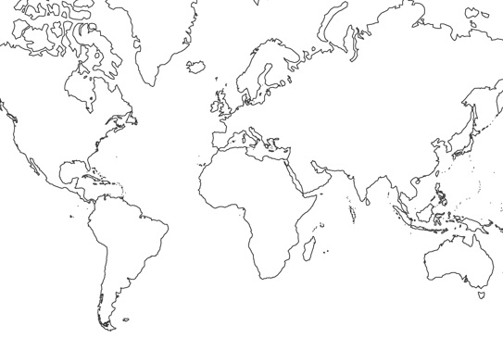
Activities by UNESCO Field offices 2018-2019
Beijing
HQ – EU project
Almaty
Beirut
Tashkent
Cairo
Amman
Dhaka
Havana
Dakar
Bangkok
Abuja
Nairobi
Lima
Harare
Santiago

Slide 37
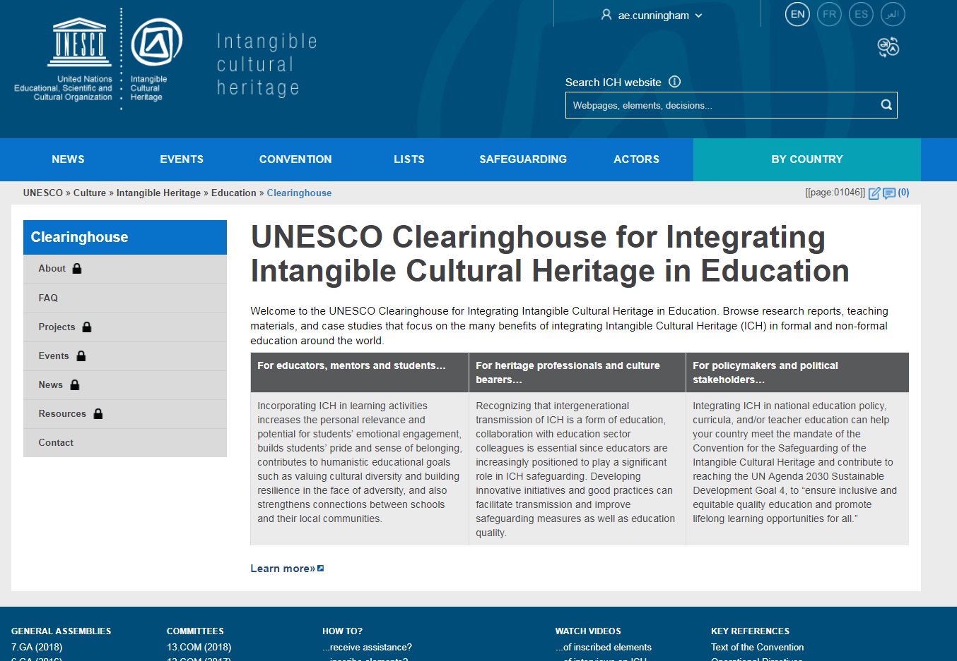
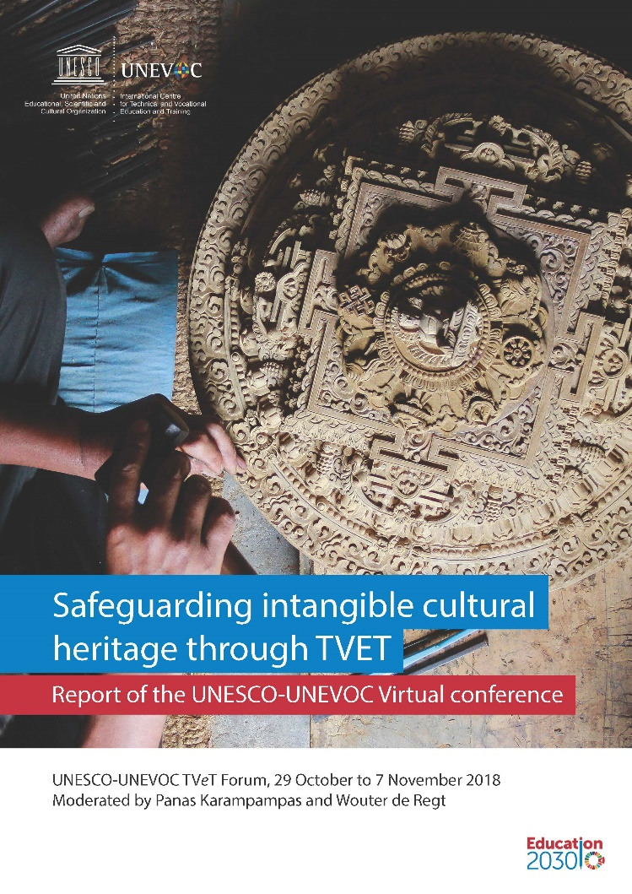
ICH and education
Recent achievements
TVET virtual conference
ESD Webinar
Support from C2Cs to intersectoral subregional meetings.
To come …
Clearinghouse (ongoing)
Policy brief (ongoing)
Side event 14.COM: Safeguarding indigenous heritage & languages through education programmes
2nd internal intersectoral programme meeting 7-8 October, 2019
Seventh Annual Coordination Meeting of C2Cs
Algiers, 2–3 September 2019

Slide 38
Discussion on upcoming workplans and possible collaboration amongst the centres and UNESCO

Slide 39
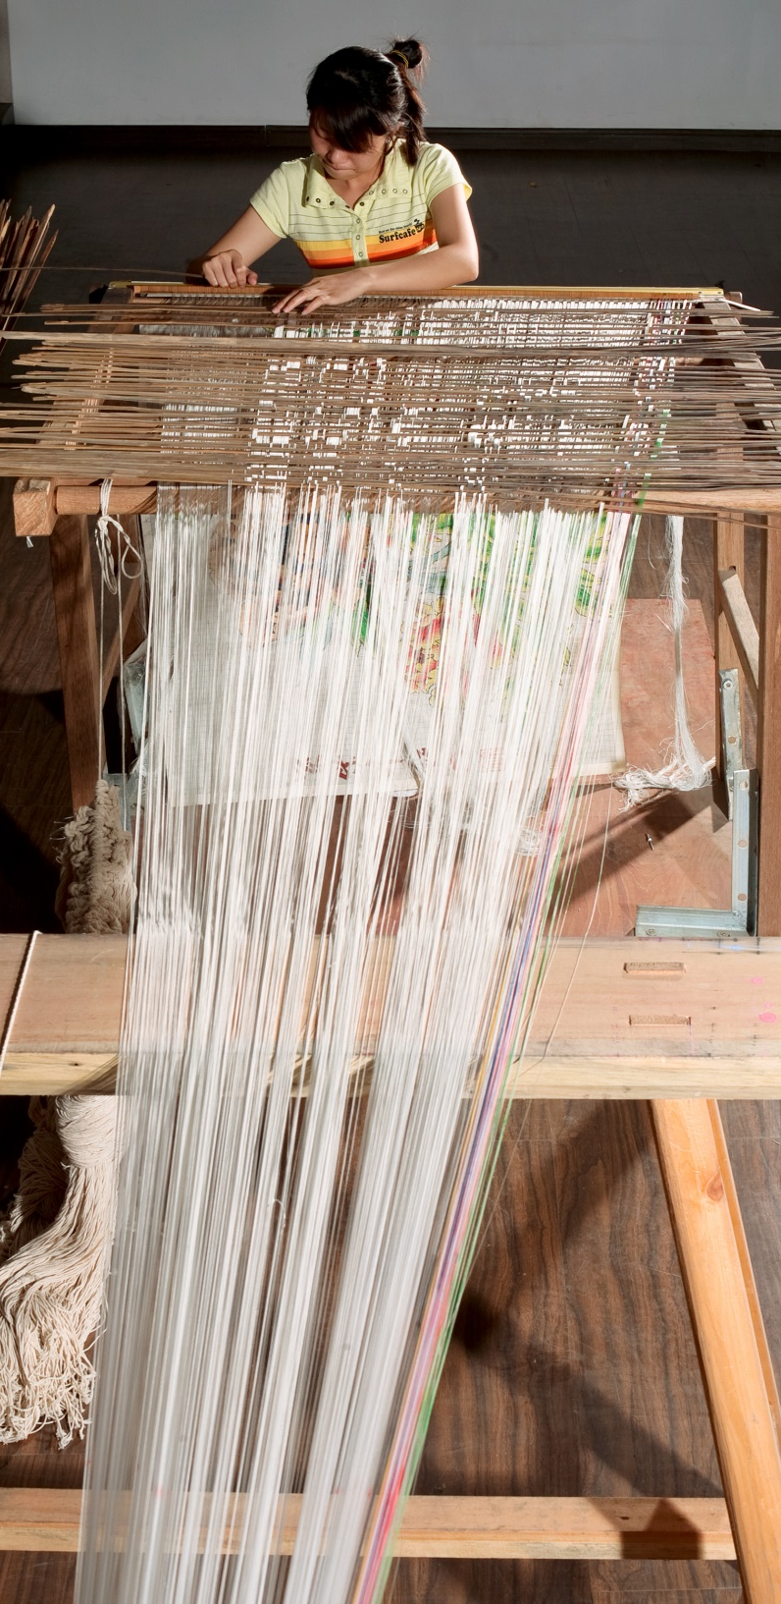
General debate on:
Upcoming workplans
Synergies and cooperation amongst the Centres and with UNESCO Secretariat
Current challenges faced by the Centres in implementing the Convention
Seventh Annual Coordination Meeting of C2Cs
Algiers, 2–3 September 2019

Slide 40
Other business

Slide 41
Annual meeting of C2Cs
      1st in Sozopol, Bulgaria, July 2013
      2nd in Paris, UNESCO HQ, June 2014
      3rd in Guiyang, China, July 2015
      4th in Paris, UNESCO HQ, June 2016
      5th in Shiraz, Iran, September 2017
      6th in Paris, UNESCO HQ, June 2018
      7th in Algiers, Algeria, September 2019
      8th in Paris, UNESCO HQ, June 2020
Seventh Annual Coordination Meeting of C2Cs
Algiers, 2–3 September 2019

