Slide 1


International Information and Networking Centre for Intangible Cultural Heritage in the Asia-Pacific Region under the auspices of UNESCO
ICHCAP
Plans and Updates

Slide 2


Since our last C2C meeting…
AGREEMENT RENEWAL UNDER PROCESS
PROGRAMS MORE ALIGNED WITH 37 C/4,C/5 & SDGs
NUMBER OF PARTICIPANT STATES PARTIES INCREASED
ESTABLISHMENT OF FIVE-YEAR PROGRAMS & STRATEGIES

Slide 3
AGREEMENT RENEWAL
NEW
Article 6.2. The specific functions of the Centre will be to:
in the A
Establish mechanisms to ensure effective sharing of information related to ICH safeguarding;
Promote ICH information by producing and publicizing on/offline ICH content to raise awareness about ICH safeguarding initiatives in the Asia-Pacific region;
Build, strengthen and maintain networks among concerned communities, groups and individual bearers of ICH, as well as relevant NGOs and civil society associations; and organize public events as appropriate;
Build, strengthen and maintain networks to exchange information and knowledge concerning the safeguarding of ICH, among relevant actors and institutions.

Slide 4
Project Implementation Management
PLAN
SEE
DO
Consultations & project idea collections
  - UNESCO(DG rep., ICH section, Fos)
  Advisory Committee for strategic program
  Feedback from stakeholders
  Project develop. Workshop
Approval at EX and GB meetings
Collaboration (Negotiation, Administrations & Monitoring)
Implementation mainly by member states
Project result reports
Review & Evaluation

Slide 5
5-Year Programs and Strategies
□ Strategic Programs
Ⅰ. Establishing and Activating ICH Information-Sharing Mechanisms
1.1 Disseminating information on ICH safeguarding activities
Ⅱ. Diversifying and Strengthening ICH Networks
2.1 Strengthening networks among ICH stakeholders
Ⅲ. Raising Visibility and Awareness on ICH
3.1 Publishing periodicals and books on ICH
Ⅳ. Increasing Efficiency in Project Planning and Management
4.1 Enhancing capacities for program planning
2.2 Operating Personnel exchanges
3.2 Supporting ICH events and raising awareness on ICH
4.2 Maintaining information-sharing and management systems
1.2 Strengthening information management capabilities in ICH

Slide 6
5-Year Programs and Strategies
□ Strategic Programs
Ⅰ. Establishment and Activation of ICH Information-Sharing Mechanisms
1.1 Dissemination of Information on ICH Safeguarding Activities
Implementing Video Documentation Project
Disseminating information on national and NGO activities for ICH safeguarding
1.2 Strengthening Information Management Capabilities in ICH
Program for supporting the digitization of ICH recordings
Strengthening capacities for ICT-based ICH information management
Producing ICH contents

Slide 7

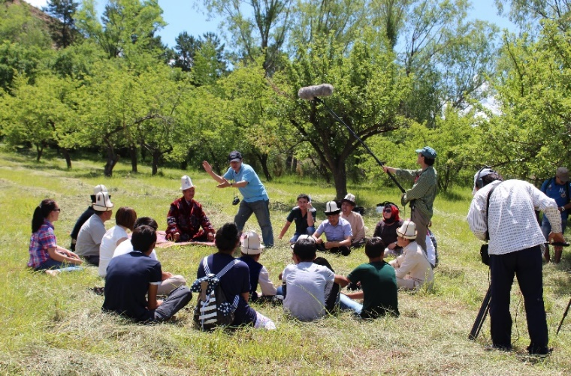
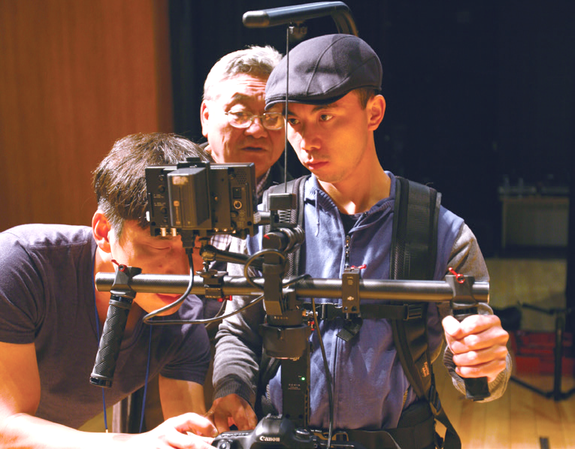
Implementing ICH Video Documentation Project
Objectives : Enhancing documentation capacities & ICH information sharing by producing and distributing video documentation
1st Stage
2nd Stage
3rd Stage
4th Stage
2015-2016
2017-2019
2020-2022
2023-2024
Central Asia, Mongolia
Pacific
Southeast Asia
South Asia
Target states | 5 | 8 | 7 | 5
Films | 50 | 80 | 70 | 50
Broadcast documentaries | 3 | 5 | 5 | 3
Notes:
ICHCAP conducted a joint project of video documentation of ICH in Asia-Pacific to promote ICH visibility. After conducting a pre-survey to select ICH elements, a joint team of recording experts will record the selected elements. Final outcome material is targeted for broadcasting.

Slide 8
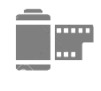
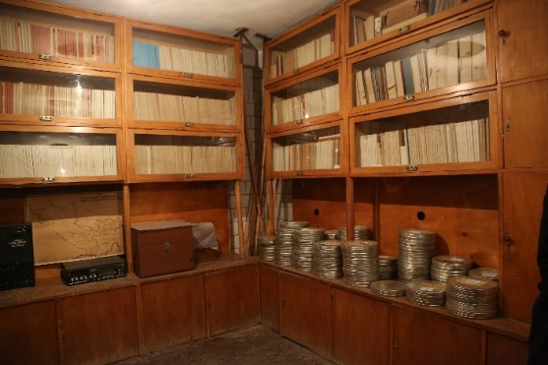
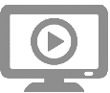
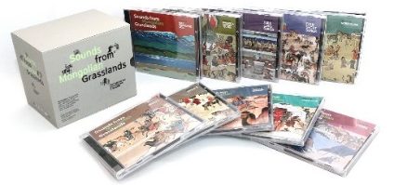
Digitizing Analogue ICH-related Audio-Video Materials
Objectives : Support digitization of ICH-related analogue materials in member states
Activities : Holding workshops, supporting digitization process, producing CD collections
Participating Countries
Mongolia (2011), Solomon Islands (2012), Vietnam (2013), Uzbekistan (2014), Philippines (2015), Nepal & India (2016), Fiji & Federated States of Micronesia (2017)
Notes:
ICHCAP’s digitization projects involve digitizing, managing, and promoting analogue audiovisual materials held in various organizations in Asia-Pacific Member States.
ICHCAP supported the restoration and digitization of Mongolian oral tradition and performing arts, folk music of Uzbekistan and Vietnam by using on and offline media, we have enhanced the accessibility of this valuable heritage to the public. The results of all these projects are available on ICHCAP’s e-Knowledge Center.
I am pleased to announce that this year we have selected two Pacific insititutes for this project. We started an open call for application for the Pacific. And recently the selecting committee made decision.
We are pleased to share the news with you that two Pacific institutes are selected as Digitalization Project beneficiaries by the selection committee. Project beneficiaries are the Yap State Historic Preservation Office (FSM), and Fiji Museum.

Slide 9

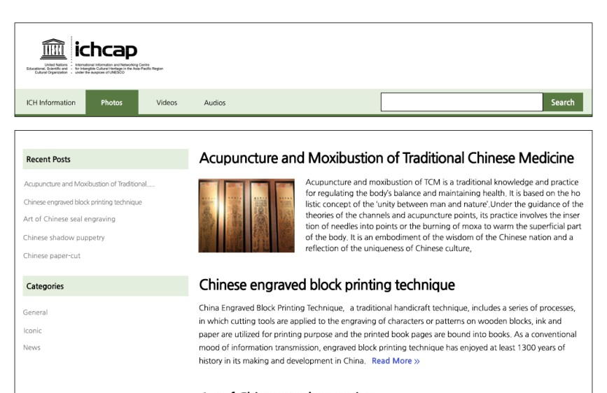
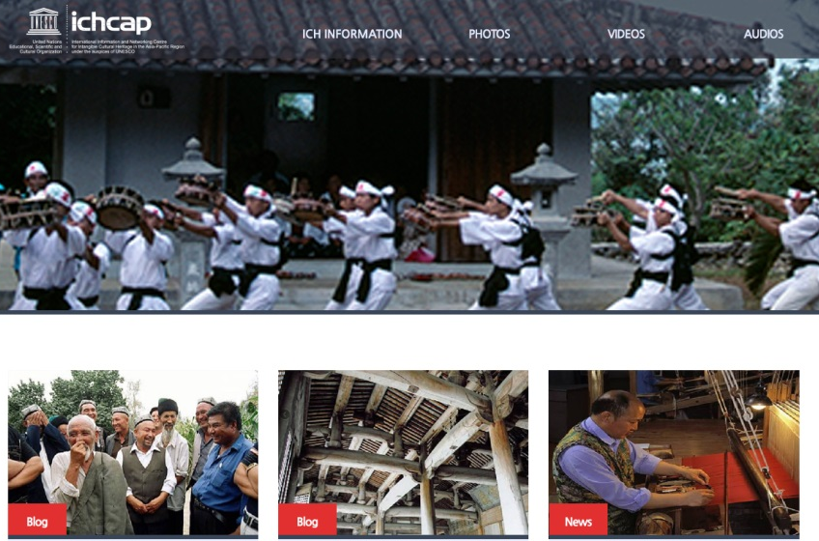
Strengthening ICH Information Management Capacity
Activities
Supporting ICH website creation and operation distributing community-based web templates
Supporting management of information-hub-institute for ICH safeguarding
2 – Blog type
4 – Text type
Notes:
무형유산 정보 기관 간 협력 시스템 구축을 통한 기초 정보 수집
공동체 기반 웹템플릿 활용 무형유산 정보시스템 구축 지원 (2016-2017)

Slide 10
5-Year Programs and Strategies
□ Strategic Programs
Ⅱ. Diversifying and Strengthening ICH Networks
2.1 Strengthening Networks Among ICH Stakeholders
Strengthening networks for communities and NGOs
Reinforcing networks for experts and relevant organizations
2.2 Operating Personnel Exchange Programs for Capacity Building
ICH professionals exchange program
Strengthening thematic networks

Slide 11
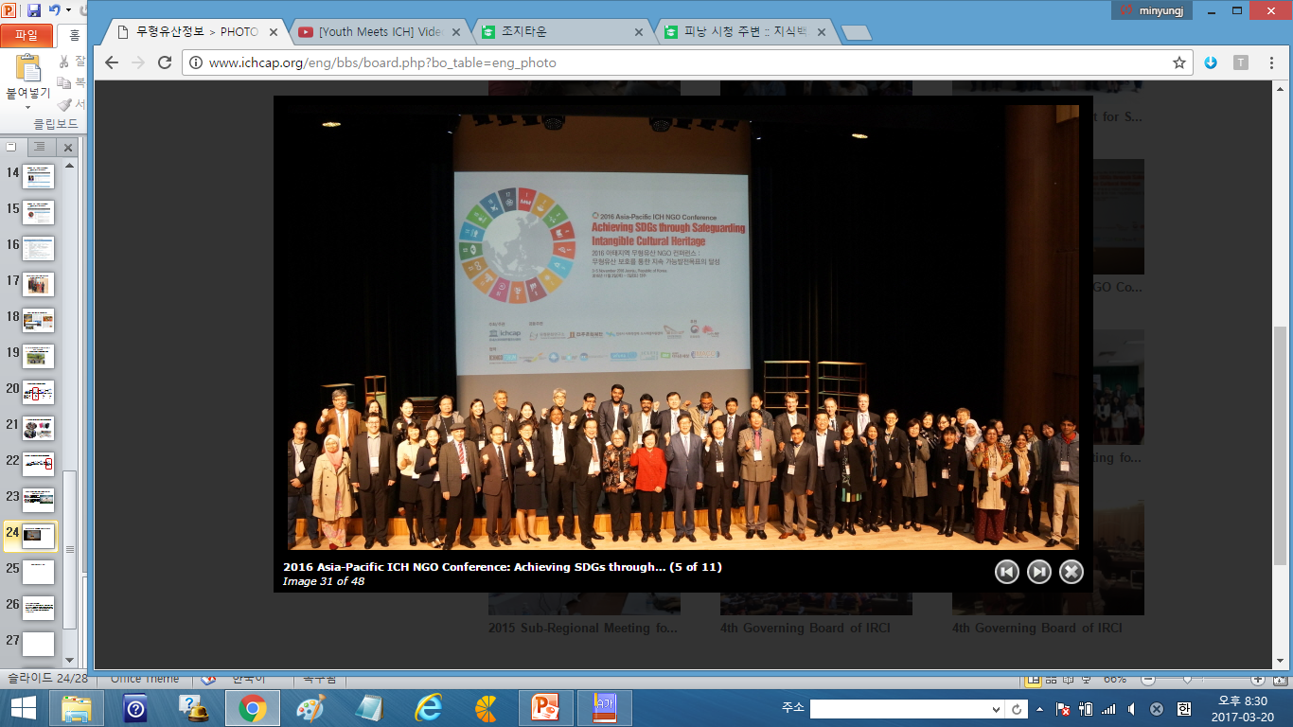
Strengthening Networks for Communities & NGOs
Activities
Developing networks among communities, for example, ship making, mask culture, earthenware pottery making
Co-organizing NGO Conference every 2 years (next meeting in 2018)
ICH NGO Conference 2016

Slide 12
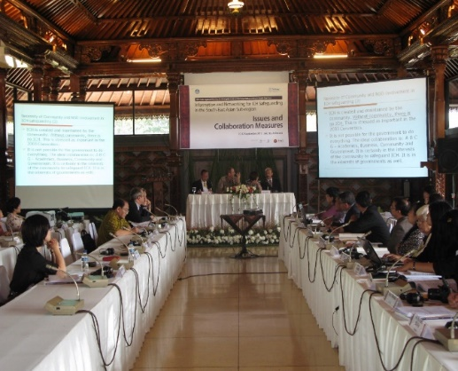
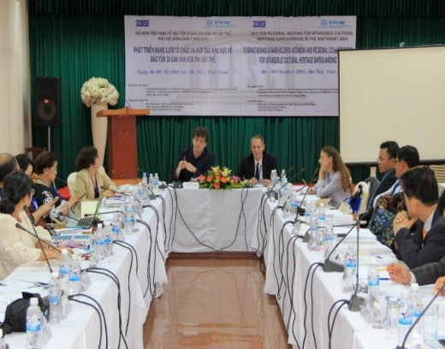
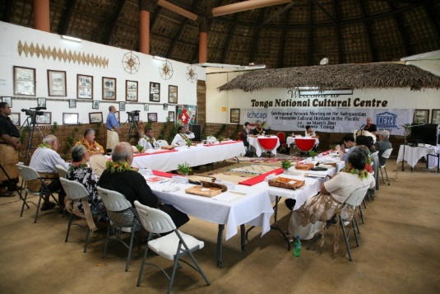
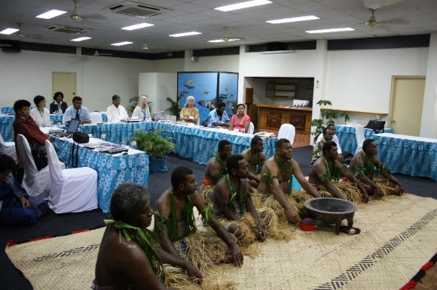
Reinforcing networks for experts and relevant organizations
Sub-regional network meetings on a regular basis (2 or 3 years)
Southeast Asia (2012, 2015 & 2017)
Central Asia (2009-2017)
South Asia (2015-2017)
The Pacific (2009-2017)
Northeast Asia (2014, 2016 & 2018)
Reinforcing coordination between ICHCAP & UNESCO

Slide 13
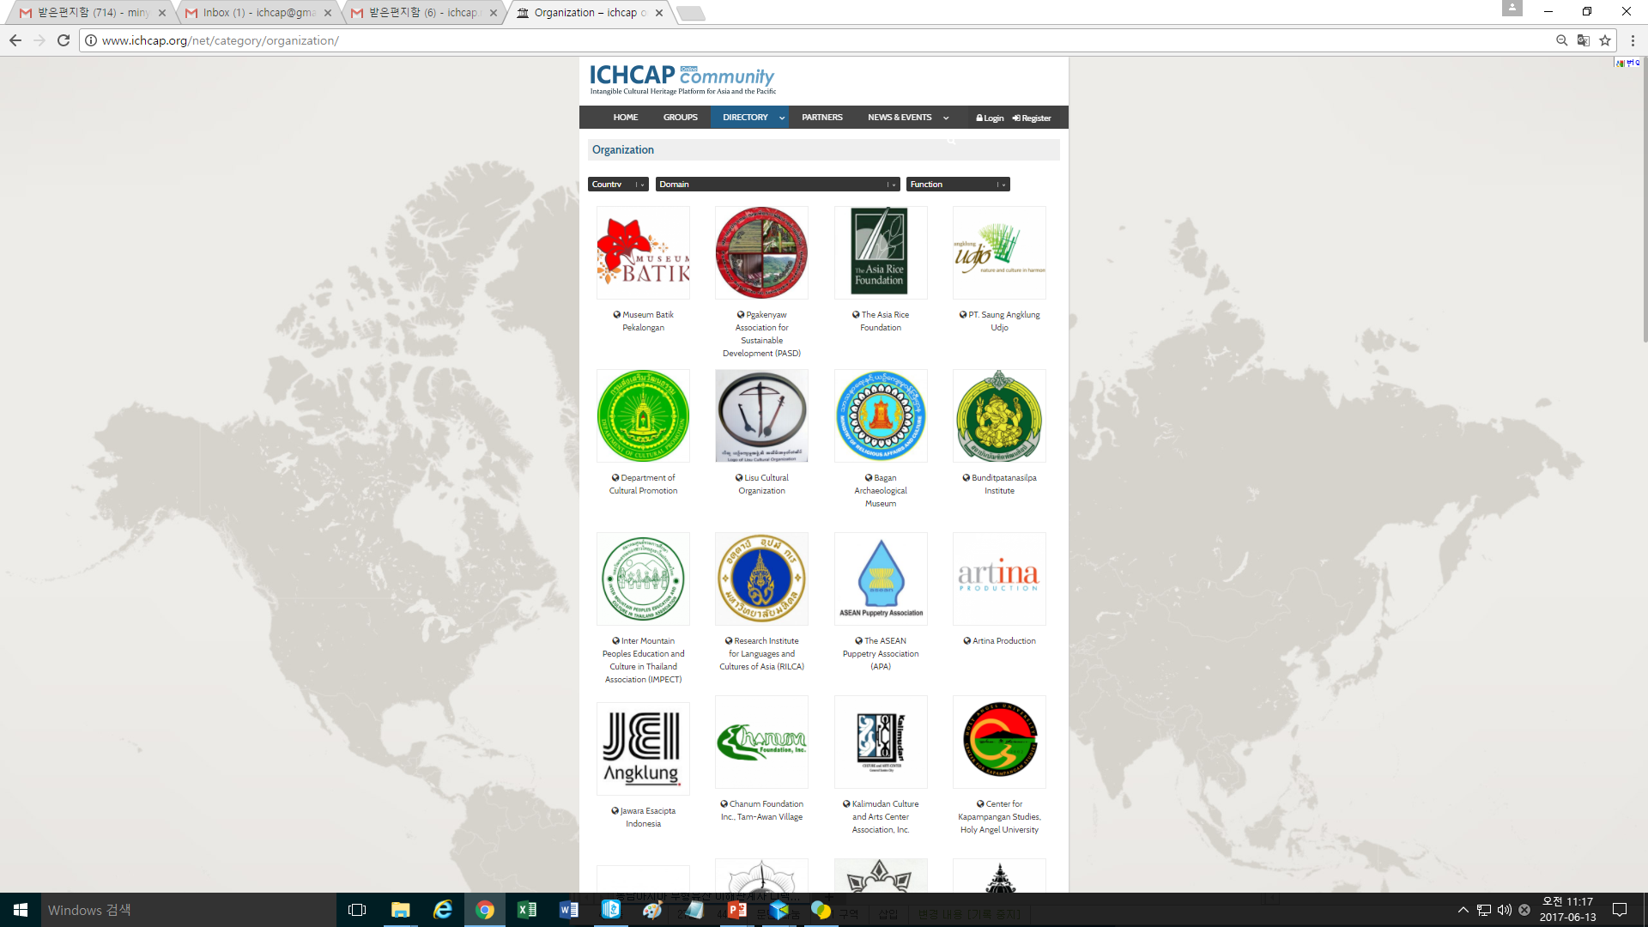
Developing ICH Stakeholder Directory
Objectives
- To identify and share useful information on ICH stakeholders
- To establish an online platform to share the information of
ICH stakeholders
Participating Countries in 2016 (1ST phase) : 7 states in Southeast Asia (Cambodia, Indonesia, Malaysia, Myanmar, Philippines, Thailand, and Vietnam)
Participating Countries in 2017 (2nd phase) : 4~6 states in South Asia
Project Results
Collected 233 information from six SEA states
Established ICHCAP Online Community Platform
(http://www.ichcap.org/net/)

Slide 14
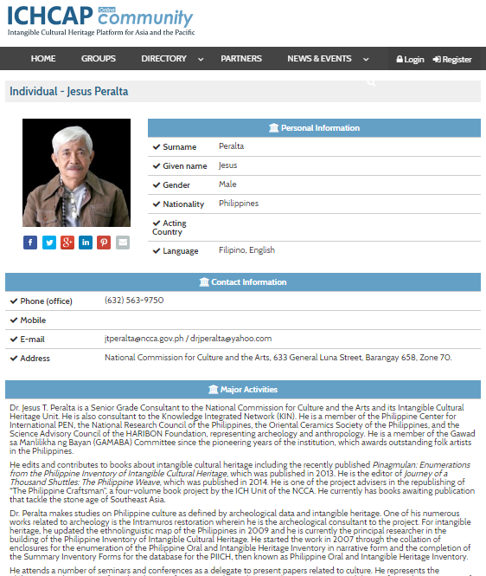

Slide 15

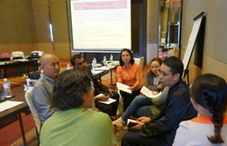
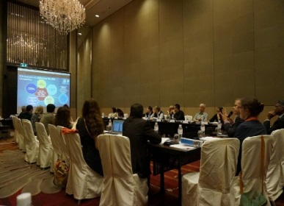
Strengthening Higher Education Networking
Survey Tertiary Education Institutions for Intangible Cultural Heritage Network
(April – November, 2017)
Roundtable Meeting on ICH Higher Education (Dec. 2017, Jeju, Korea)
Higher education networking meeting
(2018)
Partners:
UNESCO Bangkok, UNESCO ICH Section

Slide 16
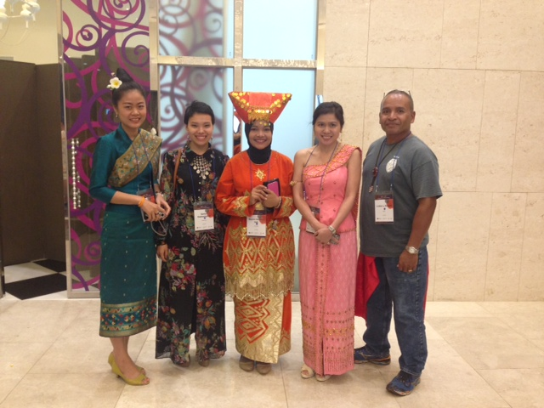

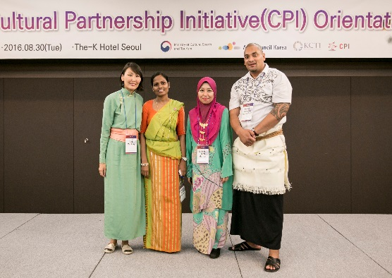
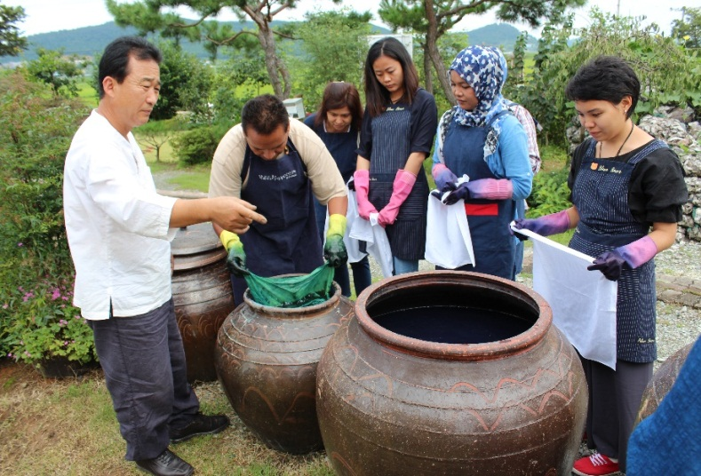
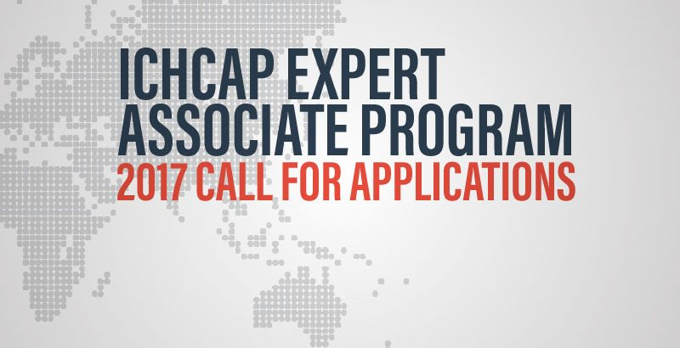
Cultural Partnership Initiative Program (CPI) &
ICH Associated Expert Program
Objectives : to facilitate ICH experts networks and exchange of professionals
Notes:
We also invite cultural heritage professionals from the Asia-Pacific region through the CPI projects.
From the Pacific, we had three CPI Participants until last year. Tonga, Fiji and Palau.
There will be an open call for the program later this year as well.
Selected pariticpants will stay for six month in Korea, and they will be supported by ICH research, and field trip. Also they will have an opportunity to be involved with ICHCAP’s project.
I encourage many Pacific colleagues to apply. You will find more details at ICHCAP’s website. www.ichcap.org

Slide 17
5-Year Programs and Strategies
□ Strategic Programs
Ⅲ. Raising visibility and awareness on ICH
3.1 Publication of Periodicals and Books on ICH
Publishing periodicals and operating an ICH correspondent program
Publishing books and supporting publications
3.2 Support for ICH Events and Raising Awareness on ICH
Supporting ICH events and festivals
Operating programs for raising awareness on ICH

Slide 18



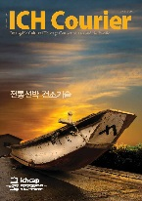

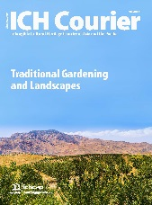
Publishing periodicals and operating an ICH correspondent program
Objectives : to enhance community participation and raise public awareness through information dissemination
Publishing ICH Courier e-Newsletter every 2 weeks
(ichcourier.ichcap.org)
Publishing ICH Courier
Notes:
ICHCAP promotes ICH visibility by publishing materials about ICH. ICHCAP publishes the ICH Courier online and offline quarterly and the ICH Courier e-news twice a month. It includes about Asia-Pacific Intangible heritage as well as information on ICHCAP activities. We also have it available for the public online at www.ichcourier.ichcap.org as you can see in middle photo. The right picture is the Korean version of UNESCO’s ICH books.
Once again, I would like to emphasize correspondent program. ICHCAP is operating the e-news correspondent program to disseminate more live information. So far, we have around fifty people working as correspondents from twenty countries. However, only four out of the fifty correspondents are from the Pacific (FSM, Tonga, Samoa, and PNG). We plan to enlarge the numbers; in particular, we would like to involve more youth in this program.

Slide 19
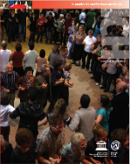
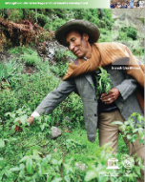
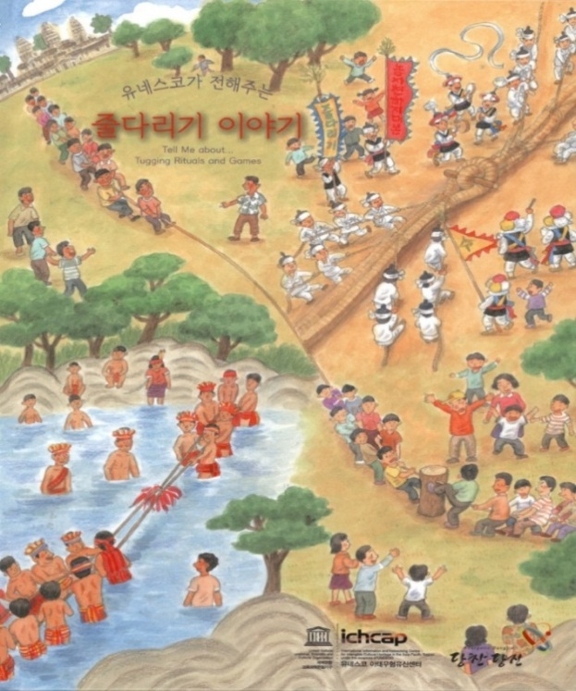
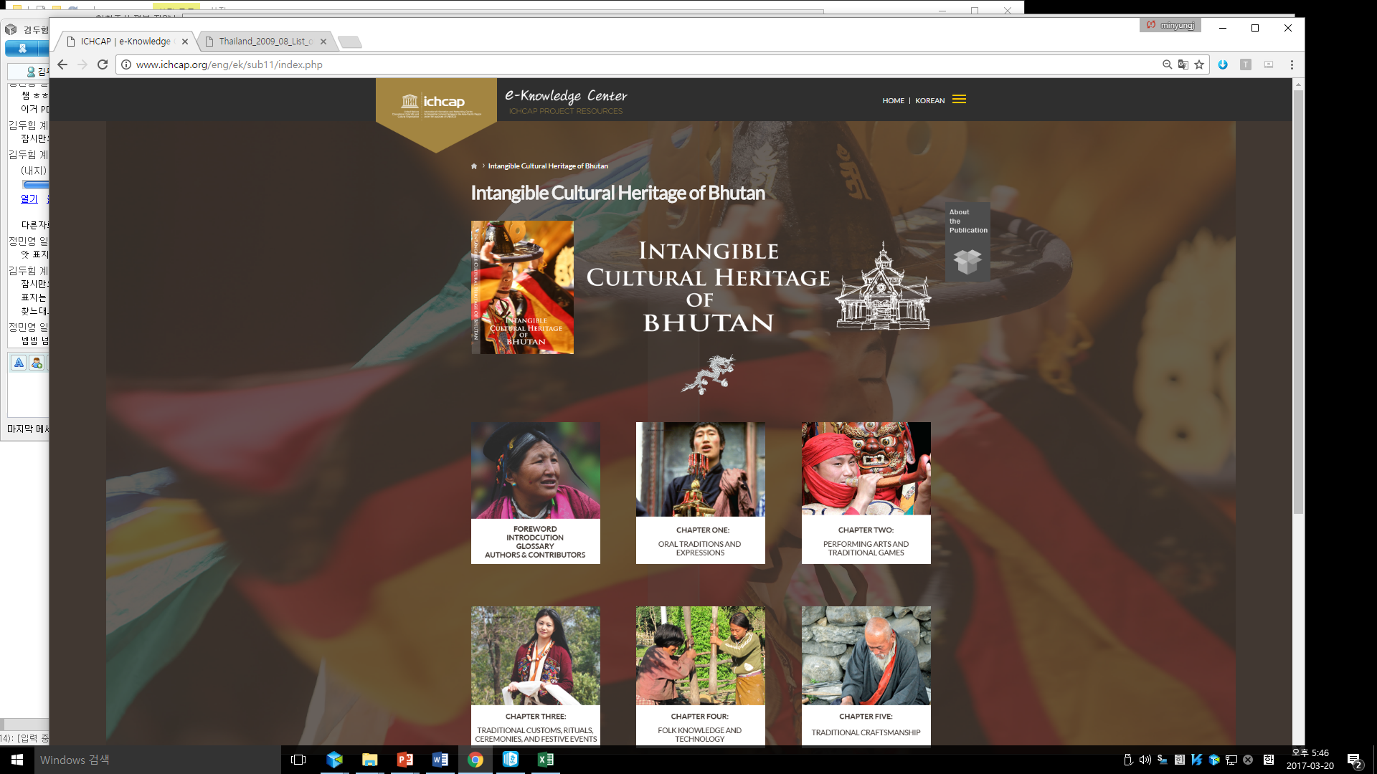

Publishing books and supporting publications in member states
Objectives : to disseminate key issues through publications on ICH and UNESCO policy
Available in Uzbek, Russian, Tongan, Malay, Mongolian
Vietnamese, Thai, Indonesian, Tamil, Korean in progress
Support publishing ICH books
(8 States / Mongolia, Philippines, Uzbekistan, Tajikistan, Bangladesh, Vietnam, Bhutan)
Publishing Multilingual Translation of UNESCO publication on ICH
Publishing Children’s book on shared heritage in Asia-Pacific

Slide 20

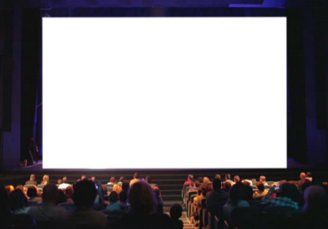
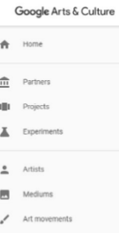
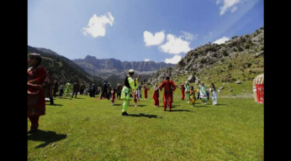

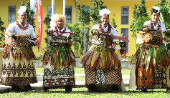
On-off line exhibitions & Film Festival
Online Exhibition with Google Cultural Institute
ICH Film Festival in Korea and Central Asia
Notes:
We also invite cultural heritage professionals from the Asia-Pacific region through the CPI projects.
From the Pacific, we had three CPI Participants until last year. Tonga, Fiji and Palau.
There will be an open call for the program later this year as well.
Selected pariticpants will stay for six month in Korea, and they will be supported by ICH research, and field trip. Also they will have an opportunity to be involved with ICHCAP’s project.
I encourage many Pacific colleagues to apply. You will find more details at ICHCAP’s website. www.ichcap.org

Slide 21
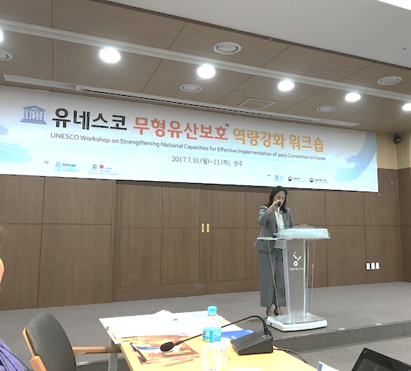
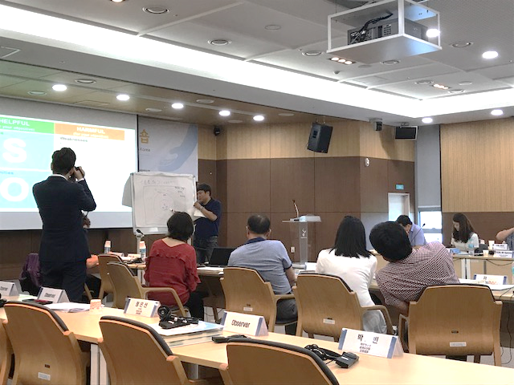
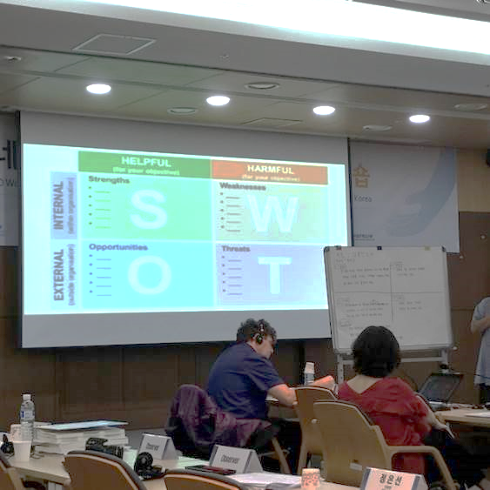
ICH Safeguarding Capacity-building Workshop in Korea (co-hosted by CRIHAP)
Dates/location : 10-13 July, 2017, Jeonju
Topics : convention implementation at the national level, community-based ICH listing, applications for inscription, ICH safeguarding planning, etc.
Participants : 30 including 18 local government officers
Second workshop in 2018 with NGOs and academics
Notes:
We also invite cultural heritage professionals from the Asia-Pacific region through the CPI projects.
From the Pacific, we had three CPI Participants until last year. Tonga, Fiji and Palau.
There will be an open call for the program later this year as well.
Selected pariticpants will stay for six month in Korea, and they will be supported by ICH research, and field trip. Also they will have an opportunity to be involved with ICHCAP’s project.
I encourage many Pacific colleagues to apply. You will find more details at ICHCAP’s website. www.ichcap.org

Slide 22
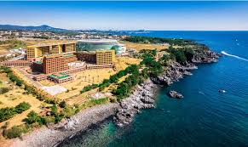
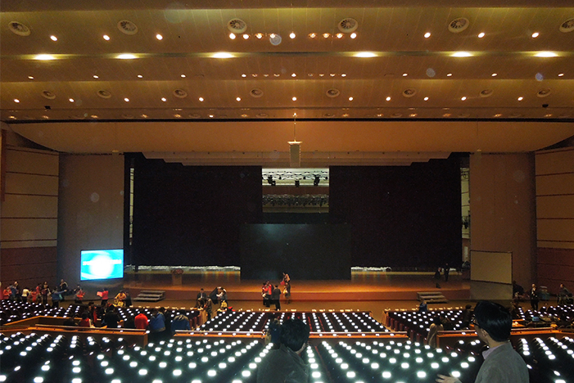
UPCOMING EVENTS
12 Session of the IGC Meeting to be held (Jeju Island, ROK from 4 to 9 December 2017)
Side events
  Roundtables for Higher Education(during IGC meeting)
  ICH NGO Forum (1-3 December)
  Symposium and Ceremony on Publication of Traditional Medicine
  Showing Central Asian ICH documentary films

Slide 23
WAY FORWARD
ICHCAP’s activities in information and networking will be directly and substantially contribute to the challenges that UNESCO encounters
  Eg. developing projects to enhance the capacity of member states in relation to periodic reporting etc.
ICHCAP will make efforts to be in line with UNESCO’s global strategy

Slide 24
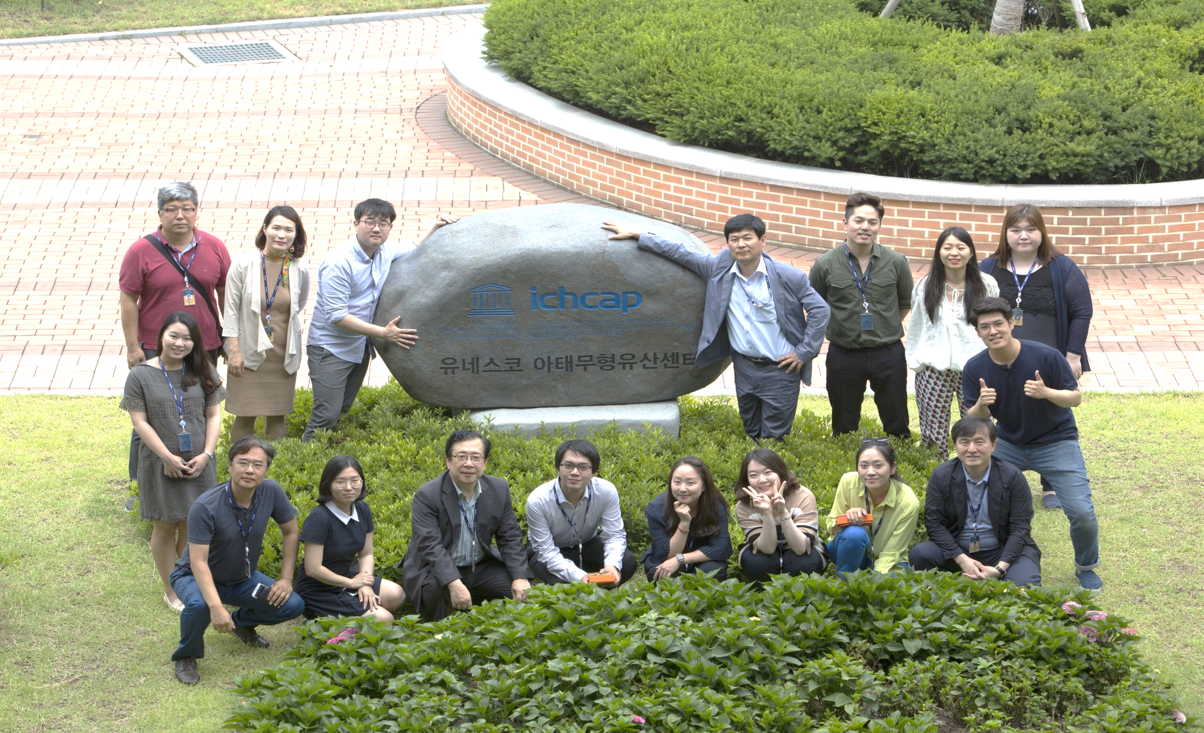
THANK YOU
www.ichcap.org

