Slide 1
PAST AND PLANNED ACTIVITIES OF THE TEHRAN ICH CENTRE
Regional Research Centre for Safeguarding Intangible Cultural Heritage in West and Central Asia

Slide 2
Western and Central Asia - a geographical mandate
Article 8 of the TICHCT Constitution:
“Considering the impossibility of defining the Intangible Cultural Heritage within official political borders of countries, due to its dynamic nature which contributes to its continuous propagation, the Centre will devote its activities to the geographical territory on which the, so called, West and Central Asian Culture exists…”

Slide 3
Four main lines of action of the Centre
Networking and international cooperation
Research and safeguarding
Disseminating information, including best practices
Training and capacity-building
Encouraging community involvement

Slide 4
Membership of the TICHCT
11 Member Countries (Afghanistan, Turkey, Pakistan, Tajikistan, Kazakhstan, Kyrgyzstan, Iraq, Armenia, Palestine, Lebanon and Iran)
8 Participating Countries in Expert Meetings (Azerbaijan, Turkmenistan, Uzbekistan, Qatar, Kuwait, Indonesia, India and Bulgaria)
9 countries which have expressed an intention to become members (Oman, Georgia, Yemen, Saudi Arabia, UAE, Bahrain, Syria, Jordon and Azerbaijan)

Slide 5
Main regional partners
Permanent Delegations of these countries to UNESCO
Two UNESCO Cluster Offices (in Tehran and Kazakhstan)
Government ministries through focal points in each Member Country
Experts and officials in each country (including university/scientific institutions)
Artists in the region
ISESCO
World Society of Islamic Cities (Qazvin, Iran)
Inter-city Intangible Cultural Cooperation Network (ICCN) based in Republic of Korea.

Slide 6
2016: Some main actions undertaken
Capacity-building (regional and national)
Awareness-raising (national and international)
Sharing information and experiences through regional and international meetings

Slide 7
Capacity-building Workshops
Regional:
Planned for Iraq and Afghanistan (security issues)
Six-day workshop on NOM in Armenia
National:
3-day workshop for staff of the Category 2 Centre and the Research Centre and Inscriptions Division of the Cultural Heritage Organization.

Slide 8
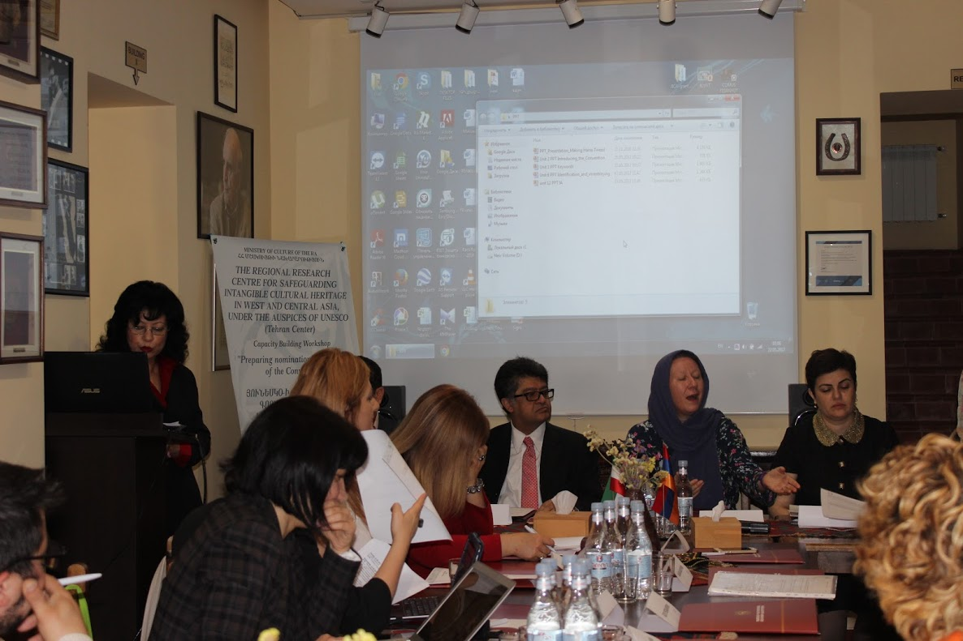
Armenia Workshop

Slide 9
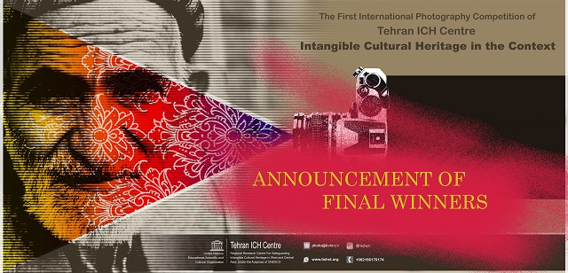
Awareness-raising
Winter Rituals Gathering
First International Competition of the Tehran ICH Centre: photographic competition on Intangible Cultural Heritage in Context

Slide 10
Regional and International Meetings
Meeting to develop a project on: Establishing Kinship Relations among ICH Elements and Local Communities in Western and Central Asia
Expert meeting on: Safeguarding Intangible Cultural Heritage for Environmental Sustainability - Concrete Proposals on Harnessing Cultural Heritage for Environmental Sustainability with leading international experts (from the US, Germany, Japan, Australia, UK and India), experts from Member Countries (Kazakhstan, Tajikistan, Armenia and Turkey), representatives from the UNESCO and UNDP Offices in Tehran and Iranian governmental and scientific bodies. There were also two presentations from Iranian NGOs.

Slide 11
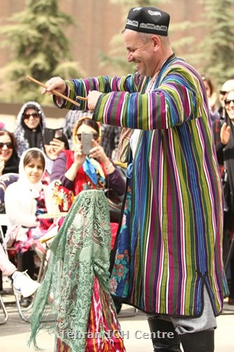
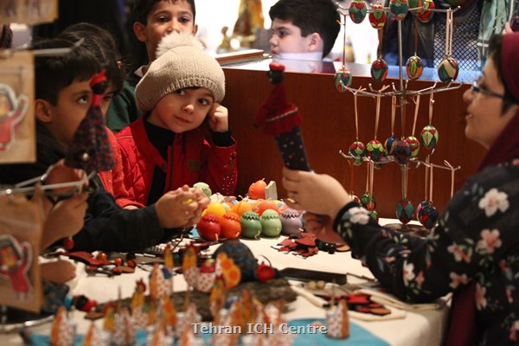
Meeting to develop a project on: Establishing Kinship Relations among ICH Elements and Local Communities in Western and Central Asia

Slide 12
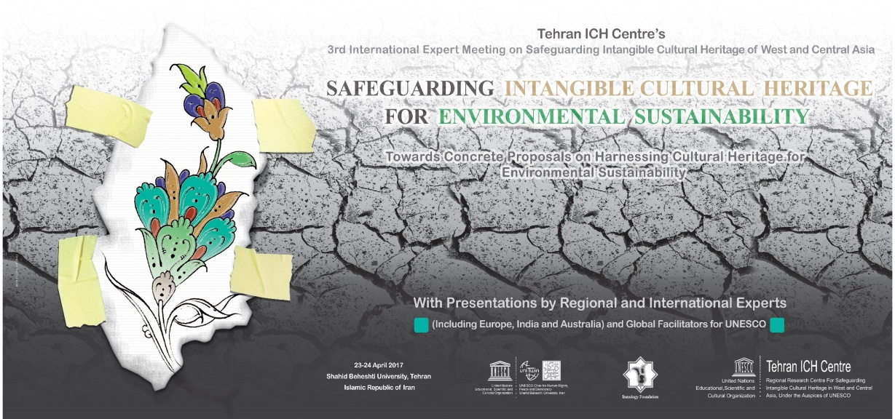
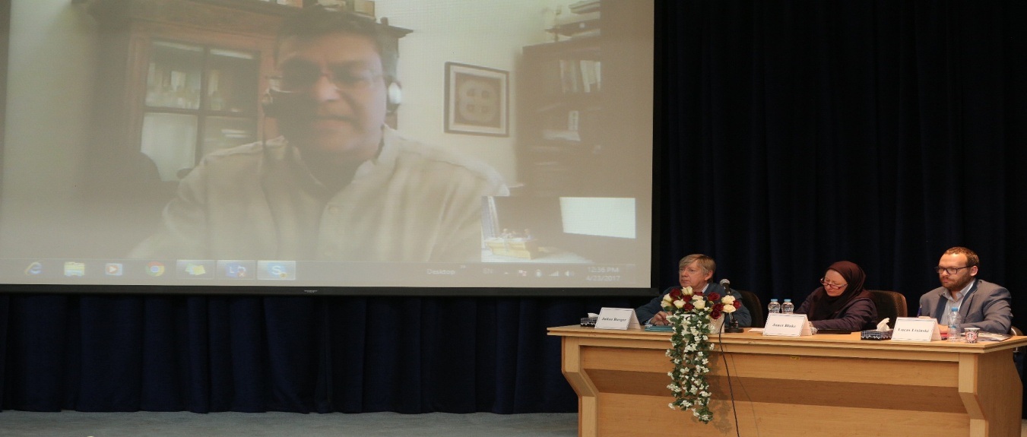
Expert meeting on: Safeguarding Intangible Cultural Heritage for Environmental Sustainability – Concrete Proposals on Harnessing Cultural Heritage for Environmental Sustainability

Slide 13
BROAD OUTLINES OF ACTIVITIES PLANNED FOR 2017-18
Publication on Safeguarding ICH in Central and Western Asia (online and print) – ICH Enquirer
Regional project on ICH-related Policy-making for Sustainable Development
Furthering regional cooperation through strengthening cultural links via ICH
Translating ICH Toolkits

Slide 14
Publication on Safeguarding ICH in Central and Western Asia
Name of publication: ICH Enquirer
Format: online and print
Languages: Persian, English and Russian
Research-based: Taking a broad notion of research and expertise
Content: experiences of good safeguarding practices, cases studies and research into ICH safeguarding and its impacts

Slide 15
Regional project on ICH-related Policy-making for Sustainable Development
Review of literature and preparation of the questionnaire: 6 months
Survey period (sending out questionnaire and receiving responses): 4 months.
Analysing the responses and preparing a follow-up meeting (including indentifying experts from the various member countries): 4 months
Holding follow-up meeting and developing stage two of the project in partnership with participants in the follow-up meeting: 4 months
Time for Stage 1: 18 months
Conducting Stage two (project/pilot project) in a number of member countries (different sub-regions): 12 months
Reporting on findings and holding a further follow-up meeting: 6 months
Total time for Stage 2: 18 months
Total time for Stages 1 and 2: 3 years

Slide 16
Furthering regional cooperation through cultural links
Seek ways of developing better regional (and sub-regional) cooperation in the field of ICH and reducing the tensions that have built up around the RL nominations
Increase the membership of the Centre and to bring together countries who have not traditionally had strong cooperation
Develop stronger links based on shared cultural elements while respecting local and national specificities (e.g. Nowrouz Dolls project)

