Slide 1
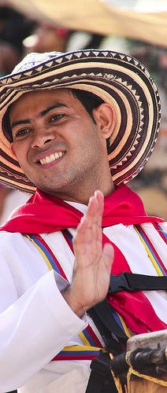
Welcome to SAFE
Introduction to the workshop and its materials
March 2016
Barranquilla Carnival (c) 2011 Matt Wootton
Notes:
Purpose of this presentation

Slide 2
SAFE WORKSHOP
  5-day workshop
  3 SAFE units: 45 – 46 - 47
  Units from IMP+ POL (IP)
  2 versions: game, non-game
  3 scenarios: Kassen, Blika, Lemnix
Notes:
2-5 days WS
Unit 55 Policy

Slide 3
SAFE UNITS
Unit 045: Introduction
  Unit 046: Scenarios and games
  Unit 047: Concluding session
Notes:
Standard workshop
45 has a lessons plan, documents + step by step gyide
45 has all scenarios + FN – carefull, FN overall + FN for each game
47: has instructions on how to run the session + multiple choice questionnaires – one HO for participants + FN with replies

Slide 4
SAFE: Other materials
Unit 1: Terminology (HO1)
+ Introducing participants (HO 2)
Unit 3: Key concepts (PT)
Unit 9: Safeguarding (PT)
Unit 55: Intellectual property
    (HO 7 + PPT 3)
Basic Texts

Slide 5
3 scenarios - 3 different settings
  Kassen
  Rural & peri-urban setting in a developing country
  Blika
  Urban setting in a rather developed country
  Limnu
  Rural setting in a poor developing country

Slide 6
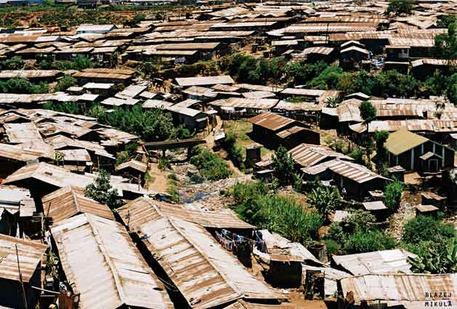
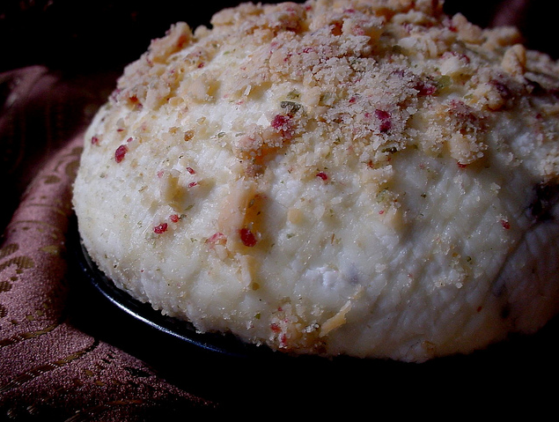
Scenario 1: Kassen
Safeguarding Fanoko, a cheese-making tradition in Kassen
  Minority community Fan
  Developing country
  Rural & peri-urban/urban area
  ICH: one clearly defined element: Fanoko cheese making
  Issues: sustainable development, intellectual property protection
  1 to 1.5 days
  10 characters (+ scribe + facilitator)

Slide 7
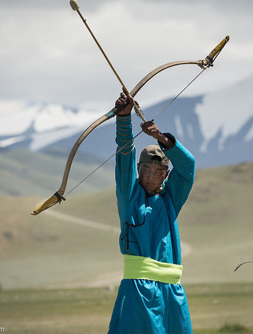
Scenario 2: Blika
Safeguarding Ori ICH in the Republic of Blika
  Immigrant community Ori
  3 main towns in a developed country
  ICH - 11 Ori elements
  3 to 4 elements for Blika inventory + develop SP for endangered ICH
  Issues: policies towards immigrants/minority groups + their impact on ICH
  2 days
  12 characters (+ scribe + facilitator)

Slide 8
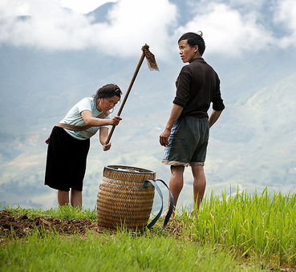
Scenario 3: Limnu
Safeguarding Limnu Valley ICH in the Kingdom of Lemnix
  Limnu/Valley people
  Two villages in a remote valley in a (poor) developing country
  ICH: The long week + Festival of the Clouds
  Safeguarding ICH as a way towards sustainable development
  Issues: outmigration, unemployment, SD, IP
  1.5 - 2 days
  13 characters (incl. scribe) + facilitator

Slide 9
NON GAME VERSIONS for all 3 scenarios
Experts invited in their own capacity
Facilitator in the role of consultant
Helping the community to develop a SP
Scenarios used as case studies
Partially different instructions and hand outs

Slide 10
For any further questions:
Capacity Building and Heritage Policies Unit
Intangible Cultural Heritage Section
Tel.: +33 1 45 68 43 30
E-mail: h.drobna@unesco.org

