Slide 1
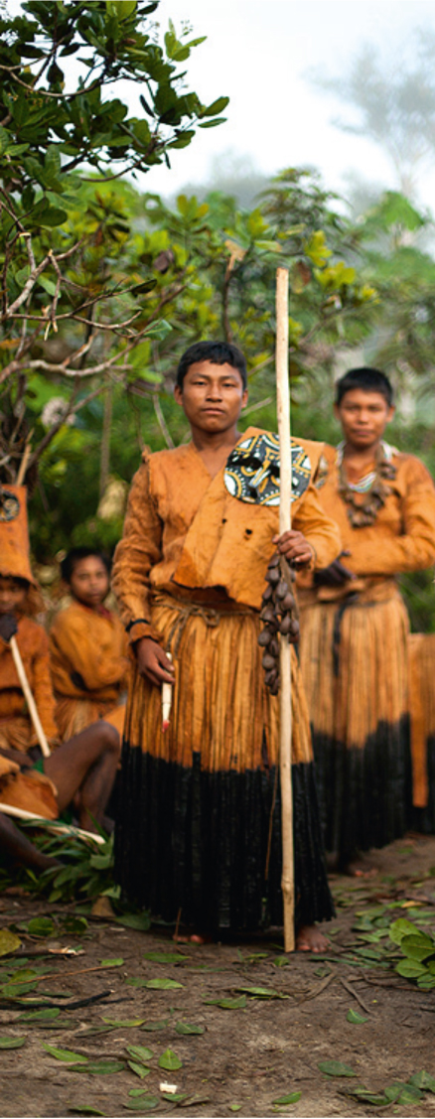
Overview of participants’ answers to the survey
strengthening the implementation of the 2003 Convention for the Safeguarding of the Intangible Cultural Heritage in Central Asia:
A SUB-REGIONAL TRAINING WORKSHOP for facilitators FOr Central Asia
Bishkek— KYRGYZSTAN
19-23 June 2017

Slide 2
Why would you like to become a trainer in ICH safeguarding under the 2003 Convention?
Support ICH safeguarding and transmission in the country, raise awareness about ICH nationally;
Deepen knowledge and skills, methodology to implement of the Convention nationally
Enhance exchanges of knowledge with other countries
Support capacity building for ICH safeguarding at the local (rural) and national levels

Slide 3
Main benefits after you attended workshops
Increased knowledge on the Convention;
Use of the Convention for the national contexts
Work on national inventories (registers), submission of nominations and work on multinational files
Enhanced cooperation and working relations among experts at sub-regional level
Who can do what at the national level (advising authorities)
Integration into national ICH expert teams
Involvement in development of ICH-related national policies
Advocacy for the role of communities and NGO in national policies

Slide 4
The most important skills and knowledge…
How to:
Enhance sub-regional cooperation mechanisms;
Enhance methodologies for building capacities
Learn more about IA mechanism
Prepare files/multinational files
Work on elements under threat
Enhance knowledge on safeguarding methods
Motivate communities to practice ICH
Conduct inventories
Conduct needs assessments for local communities
Further raise awareness about ICH
Better involve youth in ICH safeguarding.

Slide 5
Сhallenges that you encountered when teaching about ICH safeguarding.
Lack of mechanisms for systematic work with communities
Lack of communication space for interaction between facilitators and participants after seminars
How to apply theory in practice
Disruption of involvement in ICH safeguarding at national level;
Lack of training in native language/ limits of understanding training language
Explaining to communities that measures to safeguard ICH should be taken not only by state, but also by communities
Random selection of participants

